Slide 1
Elementary Linear Algebra Anton & Rorres, 9th Edition
Lecture Set – 05
Chapter 5:
General Vector Spaces

Slide 2
Chapter Content
Real Vector Spaces
Subspaces
Linear Independence
Basis and Dimension
Row Space, Column Space, and Nullspace
Rank and Nullity

Slide 3
5-1 Vector Space
Let V be an arbitrary nonempty set of objects on which two operations are defined:
Addition
Multiplication by scalars
If the following axioms are satisfied by all objects u, v, w in V and all scalars k and l, then we call V a vector space and we call the objects in V vectors.
(see Next Slide)

Slide 4
5-1 Vector Space (continue)
If u and v are objects in V, then u + v is in V.
u + v = v + u
u + (v + w) = (u + v) + w
There is an object 0 in V, called a zero vector for V, such that 0 + u = u + 0 = u for all u in V.
For each u in V, there is an object -u in V, called a negative of u, such that u + (-u) = (-u) + u = 0.
If k is any scalar and u is any object in V, then ku is in V.
k (u + v) = ku + kv
(k + l) u = ku + lu
k (lu) = (kl) (u)
1u = u
Closure
properties

Slide 5
5-1 Remarks
Depending on the application, scalars may be real numbers or complex numbers.
Vector spaces in which the scalars are complex numbers are called complex vector spaces, and those in which the scalars must be real are called real vector spaces.
Any kind of object can be a vector, and the operations of addition and scalar multiplication may not have any relationship or similarity to the standard vector operations on R^{n}.
The only requirement is that the ten vector space axioms be satisfied.
i.e. the way we define/our knowledge about (the operations on) the object is in agreement with the axioms

Slide 6
5-1 Example 1 (R^{n} Is a Vector Space)
The set V = R^{n} with the standard operations of addition and scalar multiplication is a vector space.
Axioms 1 and 6 follow from the definitions of the standard operations on R^{n}; the remaining axioms follow from Theorem 4.1.1.
The three most important special cases of R^{n} are R (the real numbers), R² (the vectors in the plane), and R³ (the vectors in 3-space).

Slide 7
5-1 Example 2 (2×2 Matrices)
Show that the set V of all 2×2 matrices with real entries is a vector space if vector addition is defined to be matrix addition and vector scalar multiplication is defined to be matrix scalar multiplication.
Let and
To prove Axiom 1, we must show that u + v is an object in V; that is, we must show that u + v is a 2×2 matrix.

Slide 8
5-1 Example 2 (continue)
Similarly, Axiom 6 hold because for any real number k we have so that ku is a 2×2 matrix and consequently is an object in V.
Axioms 2 follows from Theorem 1.4.1a since
Similarly, Axiom 3 follows from part (b) of that theorem; and Axioms 7, 8, and 9 follow from part (h), (j), and (l), respectively.

Slide 9
5-1 Example 2 (continue)
To prove Axiom 4, let Then Similarly, u + 0 = u.
To prove Axiom 5, let Then Similarly, (-u) + u = 0.
For Axiom 10, 1u = u.

Slide 10
5-1 Example 3(Vector Space of m×n Matrices)
The arguments in Example 2 can be adapted to show that the set V of all m×n matrices with real entries, together with the operations matrix addition and scalar multiplication, is a vector space.
The m×n zero matrix is the zero vector 0
If u is the m×n matrix U, then matrix –U is the negative –u of the vector u.
We shall denote this vector space by the symbol M_{mn}

Slide 11
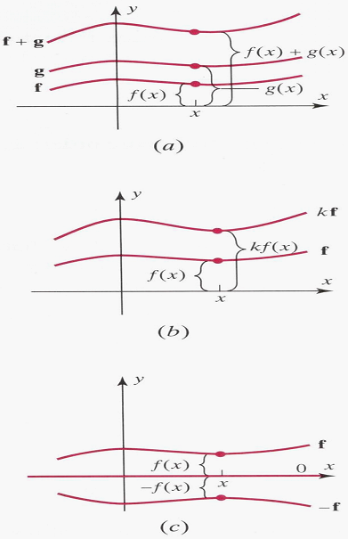
5-1 Example 4 (Vector Space of Real-Valued Functions)
Let V be the set of real-valued functions defined on the entire real line (-∞,∞).
If f = f (x) and g = g (x) are two such functions and k is any real number
The sum function : (f + g)(x) = f (x) + g (x)
The scalar multiple : (k f)(x)=k f(x).
In other words, the value of the function f + g at x is obtained by adding together the values of f and g at x (Figure 5.1.1 a).

Slide 12
5-1 Example 4 (continue)
The value of k f at x is k times the value of f at x (Figure 5.1.1 b).
This vector space is denoted by F(-∞,∞). If f and g are vectors in this space, then to say that f = g is equivalent to saying that f(x) = g(x) for all x in the interval (-∞,∞).
The vector 0 in F(-∞,∞) is the constant function that identically zero for all value of x.
The negative of a vector f is the function –f = -f(x). Geometrically, the graph of –f is the reflection of the graph of f across the x-axis (Figure 5.1.c).

Slide 13
5-1 Example 5 (Not a Vector Space)
Let V = R² and define addition and scalar multiplication operations as follows: If u = (u₁, u₂) and v = (v₁, v₂), then define
u + v = (u₁ + v₁, u₂ + v₂)
and if k is any real number, then define
k u = (k u₁, 0)
There are values of u for which Axiom 10 fails to hold. For example, if u = (u₁, u₂) is such that u₂ ≠ 0,then
1u = 1 (u₁, u₂) = (1 u₁, 0) = (u₁, 0) ≠ u
Thus, V is not a vector space with the stated operations.

Slide 14
5-1 Example 6
Every Plane Through the Origin Is a Vector Space
Let V be any plane through the origin in R³. Since R³ itself is a vector space, Axioms 2, 3, 7, 8, 9, and 10 hold for all points in R³ and consequently for all points in the plane V.
We need only show that Axioms 1, 4, 5, and 6 are satisfied.
Diagonal of the
parallelogram
is on the plane
Line through
origin is on the plane
Origin is
zero vector
Symmetric image
wrt origin is negative

Slide 15
5-1 Example 7 (The Zero Vector Space)
Let V consist of a single object, which we denote by 0, and define 0 + 0 = 0 and k 0 = 0 for all scalars k.
We called this the zero vector space.

Slide 16
Theorem 5.1.1
Let V be a vector space, u be a vector in V, and k a scalar; then:
0 u = 0
k 0 = 0
(-1) u = -u
If k u = 0 , then k = 0 or u = 0.

Slide 17
Chapter Content
Real Vector Spaces
Subspaces
Linear Independence
Basis and Dimension
Row Space, Column Space, and Nullspace
Rank and Nullity

Slide 18
5-2 Subspaces
A subset W of a vector space V is called a subspace of V if W is itself a vector space under the addition and scalar multiplication defined on V.
Theorem 5.2.1
If W is a set of one or more vectors from a vector space V, then W is a subspace of V if and only if the following conditions hold:
If u and v are vectors in W, then u + v is in W.
If k is any scalar and u is any vector in W , then ku is in W.
Remark
W is a subspace of V if and only if W is a closed under addition (condition (a)) and closed under scalar multiplication (condition (b)).
Hence, one needs to check only two of the 10 axioms! The rest hold since V is a vector space and W is a subset of V.

Slide 19
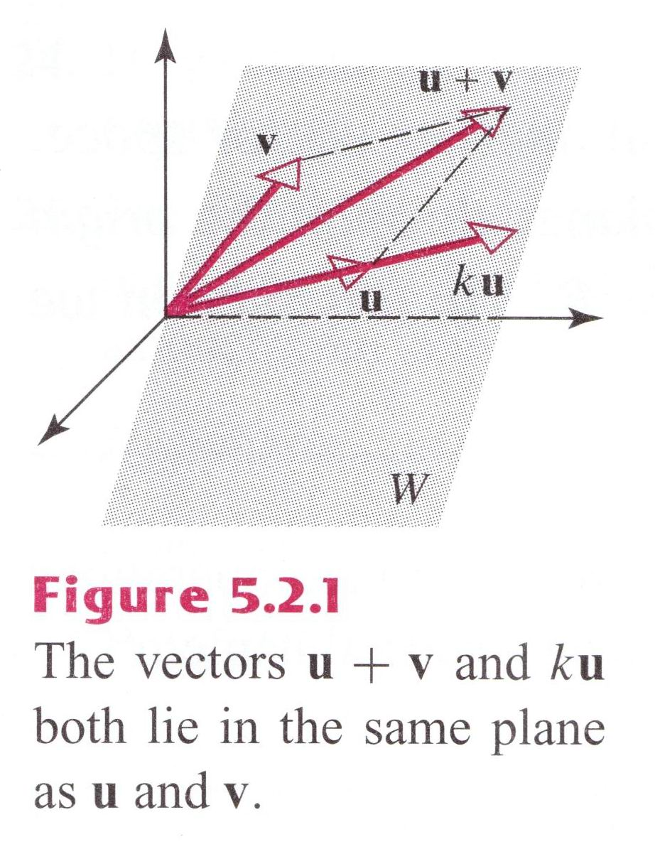
5-2 Example 1
Let W be any plane through the origin and let u and v be any vectors in W.
u + v must lie in W since it is the diagonal of the parallelogram determined by u and v, and k u must lie in W for any scalar k since k u lies on a line through u.
Thus, W is closed under addition and scalar multiplication, so it is a subspace of R³.

Slide 20
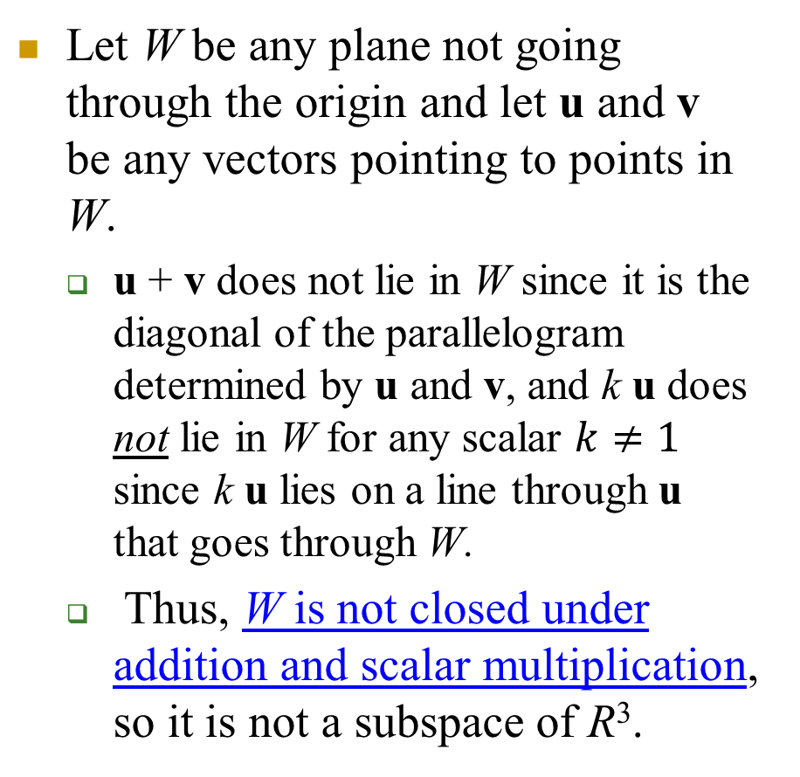
Example 1a
Let W be any plane not going through the origin and let u and v be any vectors pointing to points in W.
u + v does not lie in W since it is the diagonal of the parallelogram determined by u and v, and k u does not lie in W for any scalar $k≠1$ since k u lies on a line through u that goes through W.
Thus, W is not closed under addition and scalar multiplication, so it is not a subspace of R³.
ku
u+v
u
v

Slide 21
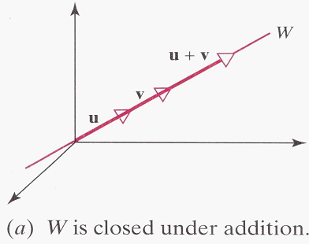
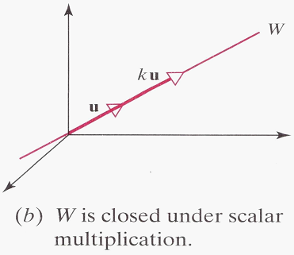
5-2 Example 2
A line through the origin of R³ is a subspace of R³.
Let W be a line through the origin of R³.

Slide 22
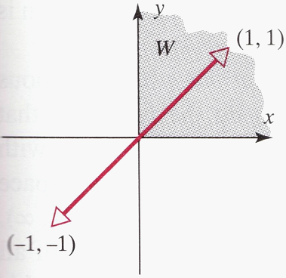
5-2 Example 3 (Not a Subspace)
Let W be the set of all points (x, y) in R² such that x ≥ 0 and y ≥ 0. These are the points in the first quadrant.
The set W is not a subspace of R² since it is not closed under scalar multiplication.
For example, v = (1, 1) lines in W, but its negative (-1)v = -v = (-1, -1) does not.

Slide 23
5-2 Subspace Remarks
Think about “set” and “empty set”!
Every nonzero vector space V has at least two trivial subspaces: V itself is a subspace, and the set {0} consisting of just the zero vector in V is a subspace called the zero subspace.
Examples of subspaces of R² and R³:
Subspaces of R²:
{0}
Lines through the origin
R²
Subspaces of R³:
{0}
Lines through the origin
Planes through origin
R³
They are actually the only subspaces of R² and R³

Slide 24
5-2 Example 4 (Subspaces of M_{nn})
The sum of two symmetric matrices is symmetric, and a scalar multiple of a symmetric matrix is symmetric.
=> the set of n×n symmetric matrices is a subspace of the vector space M_{nn} of n×n matrices.
Other subspaces of M_{nn}
the set of n×n upper triangular matrices
the set of n×n lower triangular matrices
the set of n×n diagonal matrices

Slide 25
5-2 Example 5
A subspace of polynomials of degree ≤ n
Let n be a nonnegative integer
Let W consist of all functions expressed in the form
p(x) = a₀+a₁x+…+a_{n}x^{n}
=> W is a subspace of the vector space P of all polynomials
=> W is a subspace of the vector space of all real-valued functions discussed in Example 4 of the preceding section.

Slide 26
5-2 Solution Space
Solution Space of Homogeneous Systems
If Ax = b is a system of the linear equations, then each vector x that satisfies this equation is called a solution vector of the system.
For a general b, set of solution vectors do not constitute a vector space! Ax1 = b Ax2 = b => A(x1 +x2 )= 2b
However, Theorem 5.2.2 shows that the solution vectors of a homogeneous linear system form a vector space, which we shall call the solution space of the system.

Slide 27
Theorem 5.2.2
If Ax = 0 is a homogeneous linear system of m equations in n unknowns, then the set of solution vectors is a subspace (solution space) of R^{n}.

Slide 28
5-2 Example 7
Find the solution spaces of the linear systems.
Each of these systems has three unknowns, so the solutions form subspaces of R³.
Geometrically, each solution space must be a line through the origin, a plane through the origin, the origin only, or all of R³.

Slide 29
5-2 Example 7 (continue)
Solution.
(a) RREF has one leading one, two free var. x = 2s - 3t, y = s, z = t
x = 2y - 3z or x – 2y + 3z = 0
This is the equation of the plane through the origin with
n = (1, -2, 3) as a normal vector.
(b) RREF has two leading ones, one free var. x = -5t , y = -t, z =t
which are parametric equations for the line through the origin parallel to the vector v = (-5, -1, 1).
(c) RREF has three leading ones, no free var. The solution is x = 0, y = 0, z = 0, so the solution space is the origin only, that is {0}.
(d) RREF has no leading ones, three free var. The solution are x = r , y = s, z = t, where r, s, and t have arbitrary values, so the solution space is all of R³.

Slide 30
5-2 Linear Combination
A vector w is a linear combination of the vectors v₁, v₂,…, v_{r} if it can be expressed in the form w = k₁v₁ + k₂v₂ + · · · + k_{r} v_{r} where k₁, k₂, …, k_{r} are scalars.
Example 8 (Vectors in R³ are linear combinations of i, j, and k)
Every vector v = (a, b, c) in R³ is expressible as a linear combination of the standard basis vectors
i = (1, 0, 0), j = (0, 1, 0), k = (0, 0, 1)
since
v = a(1, 0, 0) + b(0, 1, 0) + c(0, 0, 1) = a i + b j + c k

Slide 31
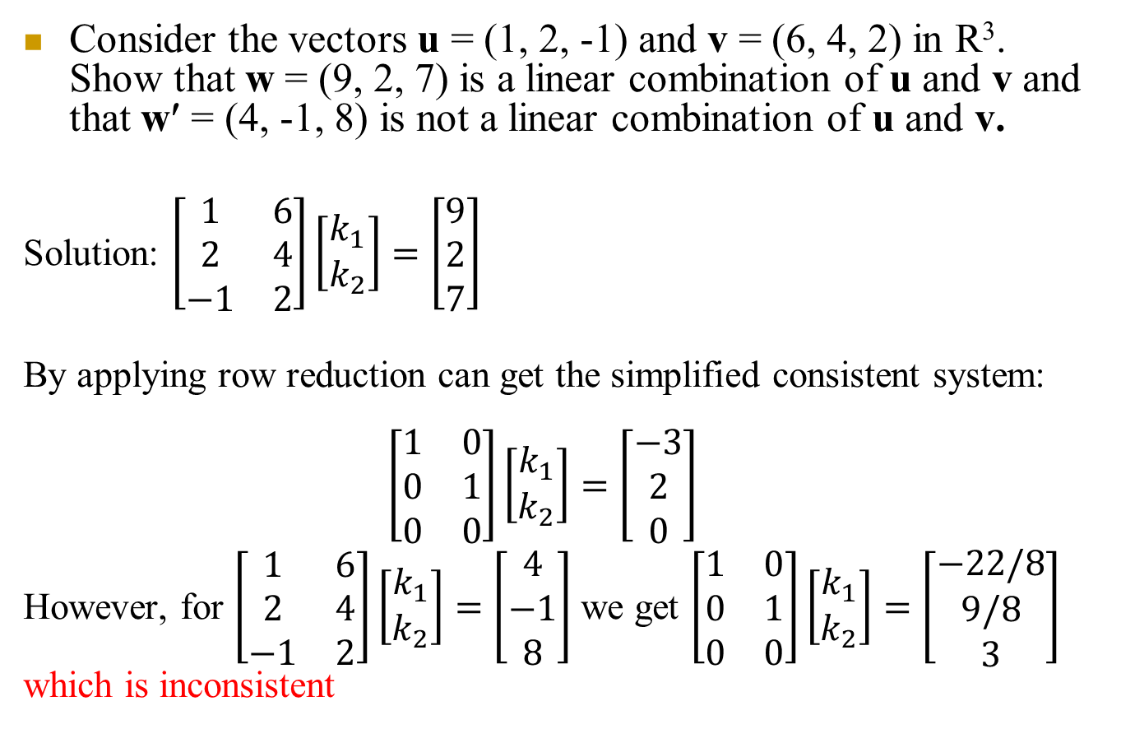
5-2 Example 9
Consider the vectors u = (1, 2, -1) and v = (6, 4, 2) in R³. Show that w = (9, 2, 7) is a linear combination of u and v and that w′ = (4, -1, 8) is not a linear combination of u and v.
Solution: $\left[\begin{matrix}1 & 6 \\ 2 & 4 \\ −1 & 2\end{matrix}\right]\left[\begin{aligned}k_{1} \\ k_{2}\end{aligned}\right]=\left[\begin{matrix}9 \\ 2 \\ 7\end{matrix}\right]$
By applying row reduction can get the simplified consistent system:
$$\left[\begin{matrix}1 & 0 \\ 0 & 1 \\ 0 & 0\end{matrix}\right]\left[\begin{aligned}k_{1} \\ k_{2}\end{aligned}\right]=\left[\begin{matrix}−3 \\ 2 \\ 0\end{matrix}\right]$$
However, for $\left[\begin{matrix}1 & 6 \\ 2 & 4 \\ −1 & 2\end{matrix}\right]\left[\begin{aligned}k_{1} \\ k_{2}\end{aligned}\right]=\left[\begin{matrix}4 \\ −1 \\ 8\end{matrix}\right]$ we get $\left[\begin{matrix}1 & 0 \\ 0 & 1 \\ 0 & 0\end{matrix}\right]\left[\begin{aligned}k_{1} \\ k_{2}\end{aligned}\right]=\left[\begin{matrix}−22/8 \\ 9/8 \\ 3\end{matrix}\right]$
which is inconsistent

Slide 32
Theorem 5.2.3
If v₁, v₂, …, v_{r} are vectors in a vector space V, then:
The set W of all linear combinations of v₁, v₂, …, v_{r} is a subspace of V.
Sum of two linear combinations is a linear combination
A scalar times a linear combination is a linear combination
W is the smallest subspace of V that contain v₁, v₂, …, v_{r} in the sense that every other subspace of V that contain v₁, v₂, …, v_{r} must contain W.
Can not reduce W by discarding any one element. Why not?
Suppose there is a strictly smaller subset which contains v₁, v₂, …, v_{r} , but not some linear combnations of them. This subset is not closed!

Slide 33
5-2 Linear Combination and Spanning
If S = {v₁, v₂, …, v_{r}} is a set of vectors in a vector space V, then the subspace W of V containing of all linear combination of these vectors in S is called the space spanned by v₁, v₂, …, v_{r}, and we say that the vectors v₁, v₂, …, v_{r} span W.
To indicate that W is the space spanned by the vectors in the set S = {v₁, v₂, …, v_{r}}, we write W = span(S) or W = span{v₁, v₂, …, v_{r}}.

Slide 34
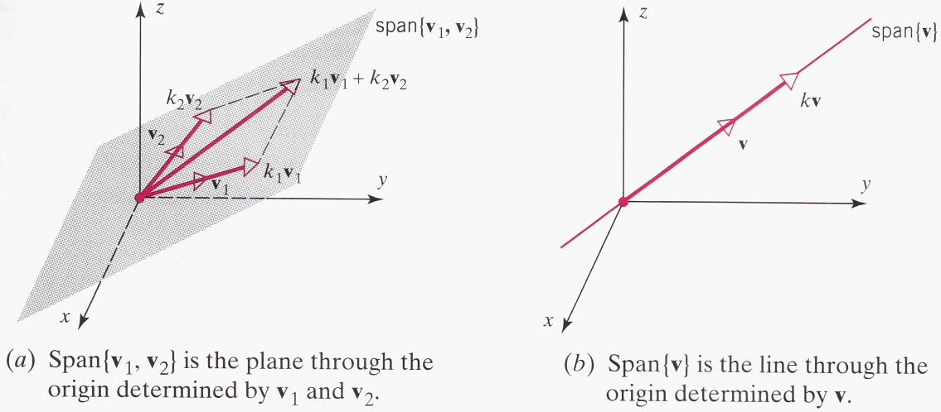
5-2 Example 10
If v₁ and v₂ are non-collinear vectors in R³ with their initial points at the origin
span{v₁, v₂}, which consists of all linear combinations k₁v₁ + k₂v₂ is the plane determined by v₁ and v₂.
Similarly, if v is a nonzero vector in R² and R³, then span{v}, which is the set of all scalar multiples kv, is the line determined by v.

Slide 35
5-2 Example 11
Spanning set for P_{n}
The polynomials 1, x, x², …, x^{n} span the vector space P_{n} defined in Example 5, the subspace of all polynomials with degree ≤n

Slide 36
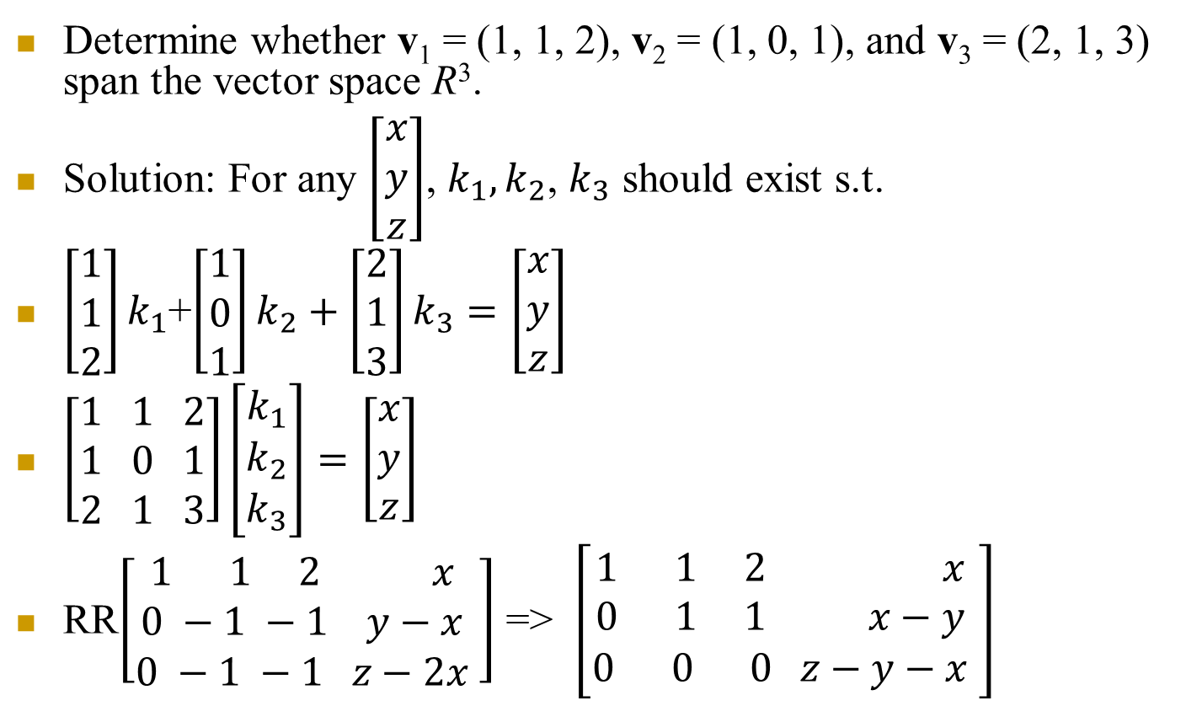
5-2 Example 12
Determine whether v₁ = (1, 1, 2), v₂ = (1, 0, 1), and v₃ = (2, 1, 3) span the vector space R³.
Solution: For any $\left[\begin{aligned}x \\ y \\ z\end{aligned}\right]$, $k_{1},k_{2}$, $k_{3}$ should exist s.t.
$\left[\begin{aligned}1 \\ 1 \\ 2\end{aligned}\right]k_{1}$+$\left[\begin{aligned}1 \\ 0 \\ 1\end{aligned}\right]k_{2}+\left[\begin{aligned}2 \\ 1 \\ 3\end{aligned}\right]k_{3}=\left[\begin{aligned}x \\ y \\ z\end{aligned}\right]$
$\left[\begin{aligned}1 1 2 \\ 1 0 1 \\ 2 1 3\end{aligned}\right]\left[\begin{aligned}k_{1} \\ k_{2} \\ k_{3}\end{aligned}\right]=\left[\begin{aligned}x \\ y \\ z\end{aligned}\right]$
RR$\left[\begin{aligned}\begin{aligned}1 1 2 x \\ 0 −1 −1 y−x\end{aligned} \\ 0 −1 −1 z−2x\end{aligned} \right]$ => $\left[\begin{aligned}\begin{aligned}1 1 2 x \\ 0 1 1 x−y\end{aligned} \\ 0 0 0 z−y−x\end{aligned} \right]$
No, they span the plane given by this constraint. Outside of the plane there
is no solution.

Slide 37
Theorem 5.2.4
If S = {v₁, v₂, …, v_{r}} and S′ = {w₁, w₂, …, w_{r}} are two sets of vector in a vector space V, then
span{v₁, v₂, …, v_{r}} = span{w₁, w₂, …, w_{r}}
if and only if
each vector in S is a linear combination of the vectors in S′ and each vector in S′ is a linear combination of the vectors in S.
Proof: Should be able to w_{j} as a linear combination of v_{i} and vice versa. Furthermore, linear combination of a linear combination is a linear combination.

Slide 38
Chapter Content
Real Vector Spaces
Subspaces
Linear Independence
Basis and Dimension
Row Space, Column Space, and Nullspace
Rank and Nullity

Slide 39
5.3 Linearly Dependent & Independent
If S = {v₁, v₂, …, v_{r}} is a nonempty set of vectors,
then the vector equation k₁v₁ + k₂v₂ + … + k_{r}v_{r} = 0 has at least one solution, namely k₁ = 0, k₂ = 0, … , k_{r} = 0.
If this the only solution, then S is called a linearly independent set. If there are other solutions, then S is called a linearly dependent set.
Example 1
If v₁ = (2, -1, 0, 3), v₂ = (1, 2, 5, -1), and v₃ = (7, -1, 5, 8).
Then the set of vectors S = {v₁, v₂, v₃} is linearly dependent, since 3v₁ + v₂ – v₃ = 0.

Slide 40
5.3 Example 3
Let i = (1, 0, 0), j = (0, 1, 0), and k = (0, 0, 1) in R³.
Consider the equation k₁i + k₂j + k₃k = 0 ⇒ k₁(1, 0, 0) + k₂(0, 1, 0) + k₃(0, 0, 1) = (0, 0, 0) ⇒ (k₁, k₂, k₃) = (0, 0, 0) ⇒ The set S = {i, j, k} is linearly independent.
Similarly the vectors
e₁ = (1, 0, 0, …,0), e₂ = (0, 1, 0, …, 0), …, e_{n} = (0, 0, 0, …, 1)
form a linearly independent set in R^{n}.
e_{j} known as standard basis vectors.

Slide 41
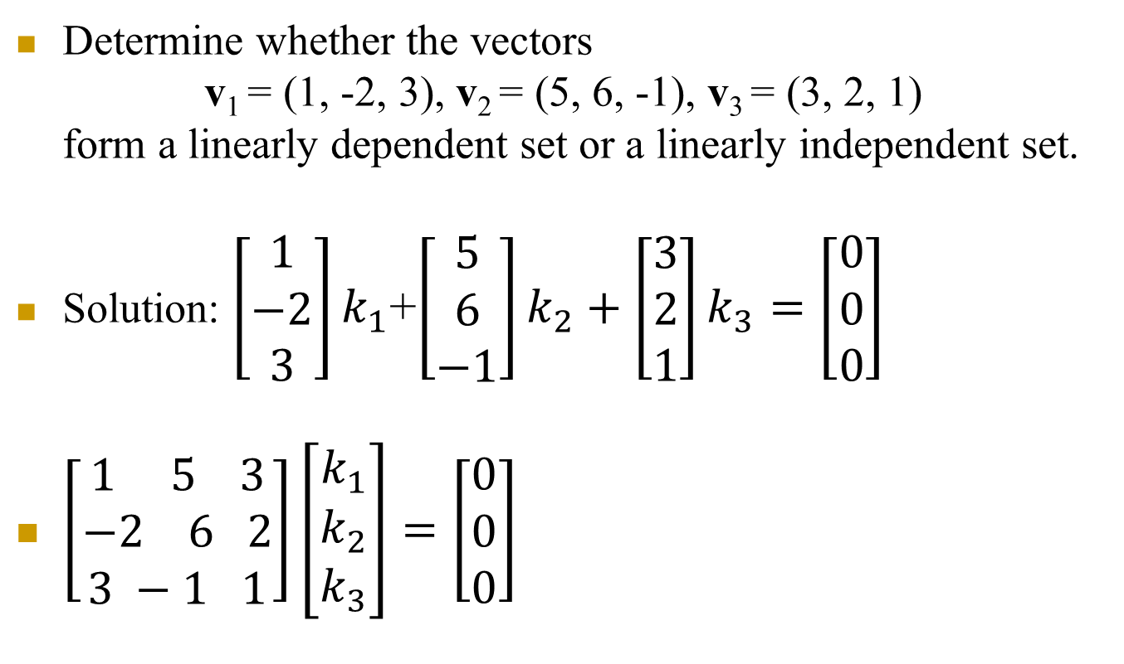
5.3 Example 4
Determine whether the vectors
v₁ = (1, -2, 3), v₂ = (5, 6, -1), v₃ = (3, 2, 1)
form a linearly dependent set or a linearly independent set.
Solution: $\left[\begin{aligned}1 \\ −2 \\ 3\end{aligned}\right]k_{1}$+$\left[\begin{aligned}5 \\ 6 \\ −1\end{aligned}\right]k_{2}+\left[\begin{aligned}3 \\ 2 \\ 1\end{aligned}\right]k_{3}=\left[\begin{aligned}0 \\ 0 \\ 0\end{aligned}\right]$
$\left[\begin{aligned}1 5 3 \\ −2 6 2 \\ 3 −1 1\end{aligned}\right]\left[\begin{aligned}k_{1} \\ k_{2} \\ k_{3}\end{aligned}\right]=\left[\begin{aligned}0 \\ 0 \\ 0\end{aligned}\right]$

Slide 42
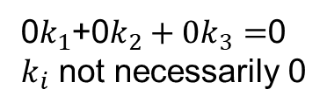

Example 4 cont.
RR: $\left[\begin{aligned}1 5 3 \\ −2 6 2 \\ 3 −1 1\end{aligned}\begin{aligned} 0 \\ 0 \\ 0\end{aligned}\right]$=>$\left[\begin{aligned}1 5 3 \\ 0 16 8 \\ 0 −16 −8\end{aligned}\begin{aligned} 0 \\ 0 \\ 0\end{aligned}\right]$
=>$\left[\begin{aligned}1 5 3 \\ 0 16 8 \\ 0 0 0\end{aligned}\begin{aligned} 0 \\ 0 \\ 0\end{aligned}\right]$
0$k_{1}$+0$k_{2}+0k_{3}=$0
$k_{i}$ not necessarily 0

Slide 43

5.3 Example 5
Show that the polynomials
1, x, x²,…, x^{n} form a linear independent set of vectors in P_{n}
Proof: Can not express x^{j} as a linear combination of x^{i} for $i≠j$

Slide 44
Theorem 5.3.1
A set S with two or more vectors is:
Linearly dependent if and only if at least one of the vectors in S is expressible as a linear combination of the other vectors in S.
Linearly independent if and only if no vector in S is expressible as a linear combination of the other vectors in S.

Slide 45
5.3 Example 6
If v₁ = (2, -1, 0, 3), v₂ = (1, 2, 5, -1), and v₃ = (7, -1, 5, 8).
the set of vectors S = {v₁, v₂, v₃} is linearly dependent
In this example each vector is expressible as a linear combination of the other two since it follows from the equation 3v₁+v₂-v₃=0 that
v₁=-1/3v₂+1/3v₃,
v₂=-3 v₁+v₃, and
v₃=3v₁+v₂

Slide 46
5.3 Example 7
Let i = (1, 0, 0), j = (0, 1, 0), and k = (0, 0, 1) in R³.
The set S = {i, j, k} is linearly independent.
Suppose, to the contrary, that k is expressible as k=k₁i+k₂j
Then, in terms of components,
(0, 0, 1)=k₁(1, 0, 0)+k₂(0, 1, 0) or (0, 0, 1)=(k₁, k₂, 0)

Slide 47
Theorem 5.3.2
A finite set of vectors that contains the zero vector is linearly dependent.
Can multiply the zero vector with any constant (not necessarily zero) inside the linear combination which is set to zero.
A set with exactly two vectors is linearly independently if and only if neither vector is a scalar multiple of the other.
Example 8
The functions f1=x and f2=sin x form a linear independent set of vectors in F(-∞, ∞).
One is not a scalar multiple of the other.

Slide 48
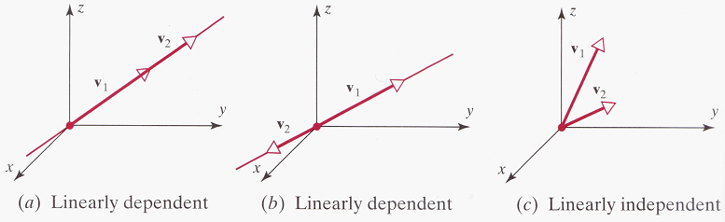
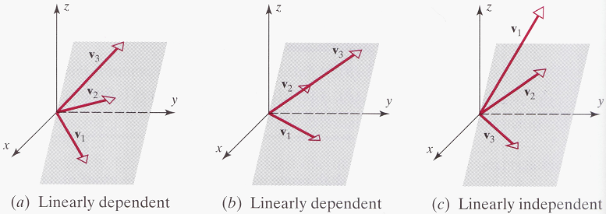
5.3 Geometric Interpretation of Linear Independence
In R² and R³, a set of two vectors is linearly independent if and only if the vectors do not lie on the same line when they are placed with their initial points at the origin.
In R³, a set of three vectors is linearly independent if and only if the vectors do not lie in the same plane when they are placed with their initial points at the origin.

Slide 49
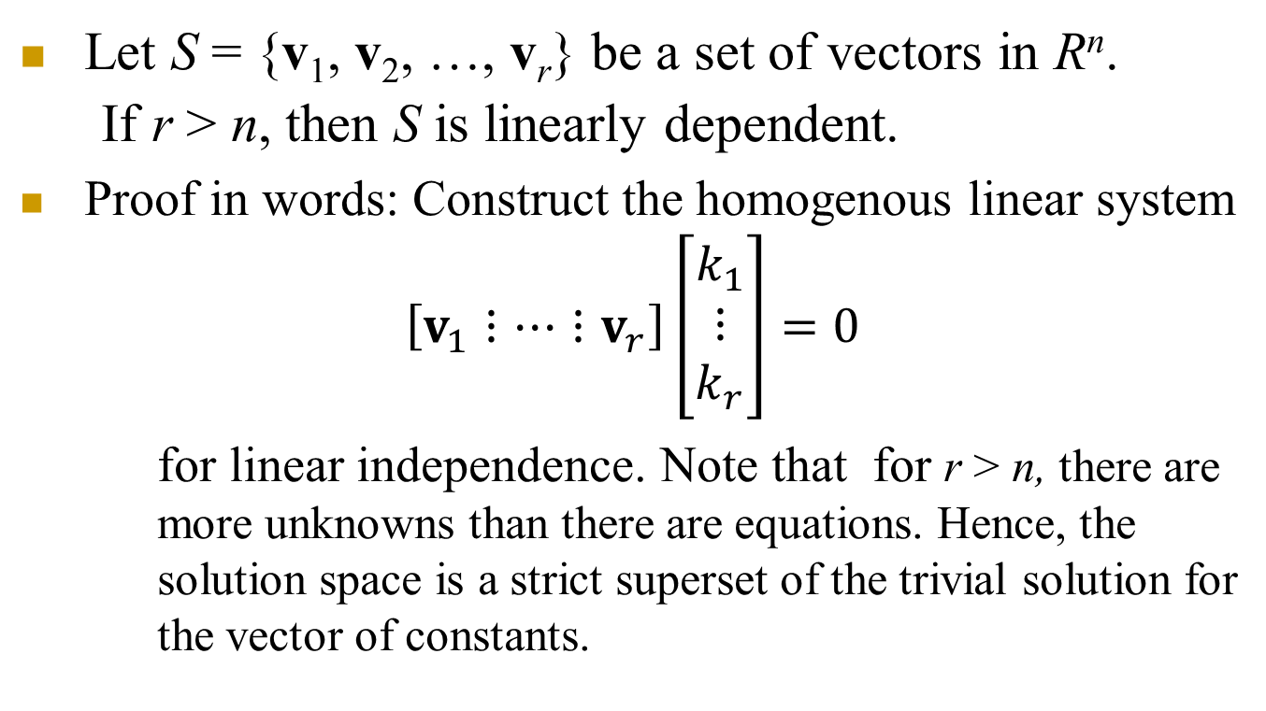
Theorem 5.3.3
Let S = {v₁, v₂, …, v_{r}} be a set of vectors in R^{n}.
If r > n, then S is linearly dependent.
Proof in words: Construct the homogenous linear system
$$\left[v_{1}⋮⋯⋮v_{r}\right]\left[\begin{aligned}k_{1} \\ ⋮ \\ k_{r}\end{aligned}\right]=0$$
for linear independence. Note that for r > n, there are more unknowns than there are equations. Hence, the solution space is a strict superset of the trivial solution for the vector of constants.

Slide 50
Chapter Content
Real Vector Spaces
Subspaces
Linear Independence
Basis and Dimension
Row Space, Column Space, and Nullspace
Rank and Nullity

Slide 51
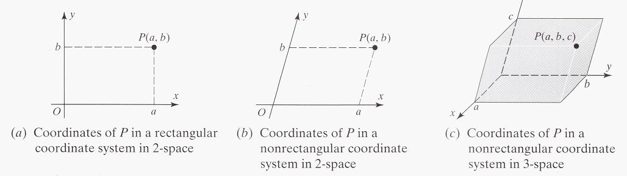
5-4 Nonrectangular Coordinate Systems
The coordinate system in R² establishes a one-to-one correspondence between points in the plane and ordered pairs of real numbers.
Although perpendicular coordinate axes are the most common, any two nonparallel lines can be used to define a coordinate system in the plane in R².

Slide 52
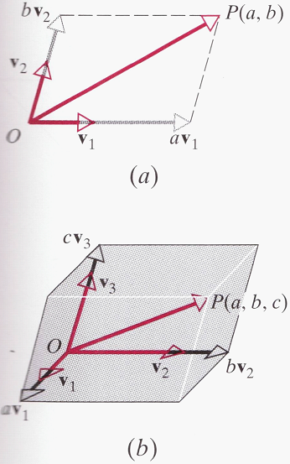
5-4 Nonrectangular Coordinate Systems
A coordinate system can be constructed by general vectors:
v₁ and v₂ are vectors of length 1 that points in the positive direction of the axis:
Similarly, the coordinates (a, b, c) of the point P in R³ can be obtained by expressing as a linear combination of the vectors v₁ , v₂ , v₃

Slide 53
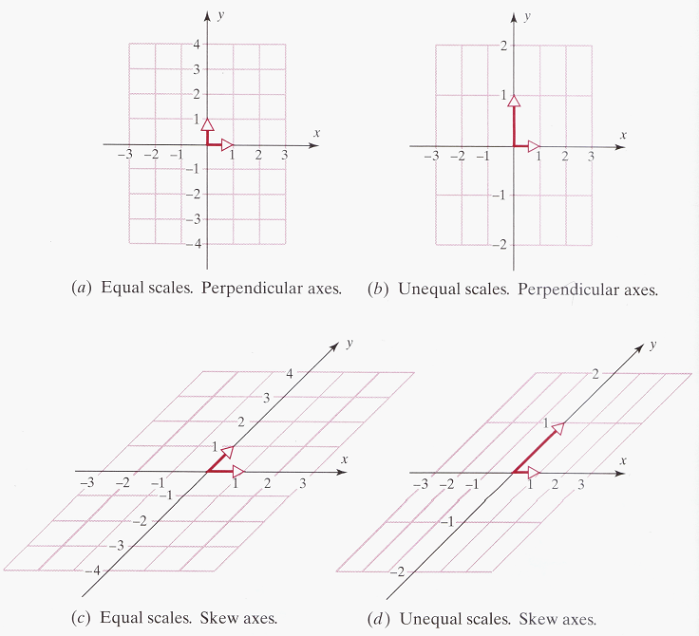
5-4 Nonrectangular Coordinate Systems
Informally stated, vectors that specify a coordinate system are called “basis vectors” for that system.
nonzero vectors of any length will suffice

Slide 54
5-4 Basis
If V is any vector space and S = {v₁, v₂, …,v_{n}} is a set of vectors in V, then S is called a basis for V if the following two conditions hold:
S is linearly independent.
S spans V.
Theorem 5.4.1 (Uniqueness of Basis Representation)
If S = {v₁, v₂, …,v_{n}} is a basis for a vector space V, then every vector v in V can be expressed in the form
v = c₁v₁ + c₂v₂ + … + c_{n}v_{n}
in exactly one way.

Slide 55
Proof of Theorem 5.4.1
Suppose the theorem does not hold. Then we should be able to write both
v = c₁v₁ + c₂v₂ + … + c_{n}v_{n}
v = k₁v₁ + k₂v₂ + … + k_{n}v_{n} for two sets of constants
0 = (c₁-k₁)v₁ + (c₂-k₂) v₂ + … + (c_{n}-k_{n}) v_{n}
Due to linear independence (c_{i}-k_{i})=0 for all i.
which contradicts the existence of two sets!

Slide 56
5-4 Coordinates Relative to a Basis
If S = {v₁, v₂, …, v_{n}} is a basis for a vector space V, and
v = c₁v₁ + c₂v₂ + ··· + c_{n}v_{n}
is the expression for a vector v in terms of the basis S, then the scalars c₁, c₂, …, c_{n}, are called the coordinates of v relative to the basis S.
The vector (c₁, c₂, …, c_{n}) in R^{n} constructed from these coordinates is called the coordinate vector of v relative to S; it is denoted by
(v)_{S} = (c₁, c₂, …, c_{n})
Remark:
Coordinate vectors depend not only on the basis S but also on the order in which the basis vectors are written.

Slide 57
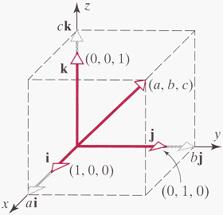
5-4 Example 1 (Standard Basis for R³)
Suppose that i = (1, 0, 0), j = (0, 1, 0), and k = (0, 0, 1)
S = {i, j, k} is a linearly independent set in R³.
S also spans R³ since any vector v = (a, b, c) in R³ can be written as
v = (a, b, c) = a(1, 0, 0) + b(0, 1, 0) + c(0, 0, 1) = ai + bj + ck
Thus, S is a basis for R³; it is called the standard basis for R³.
Looking at the coefficients of i, j, and k,
(v)_{S} = (a, b, c)
Comparing this result to v = (a, b, c),
v = (v)_{S}

Slide 58
5-4 Example 2 (Standard Basis for R^{n})
If e₁ = (1, 0, 0, …, 0), e₂ = (0, 1, 0, …, 0), …, e_{n} = (0, 0, 0, …, 1),
S = {e₁, e₂, …, e_{n}} is a linearly independent set in R^{n}
S also spans R^{n} since any vector v = (v₁, v₂, …, v_{n}) in R^{n} can be written as
v = v₁e₁ + v₂e₂ + … + v_{n}e_{n}
Thus, S is a basis for R^{n}; it is called the standard basis for R^{n}.
The coordinates of v = (v₁, v₂, …, v_{n}) relative to the standard basis are v₁, v₂, …, v_{n}, thus
(v)_{S} = (v₁, v₂, …, v_{n}) => v = (v)_{s}
A vector v and its coordinate vector relative to the standard basis for R^{n} are the same.

Slide 59
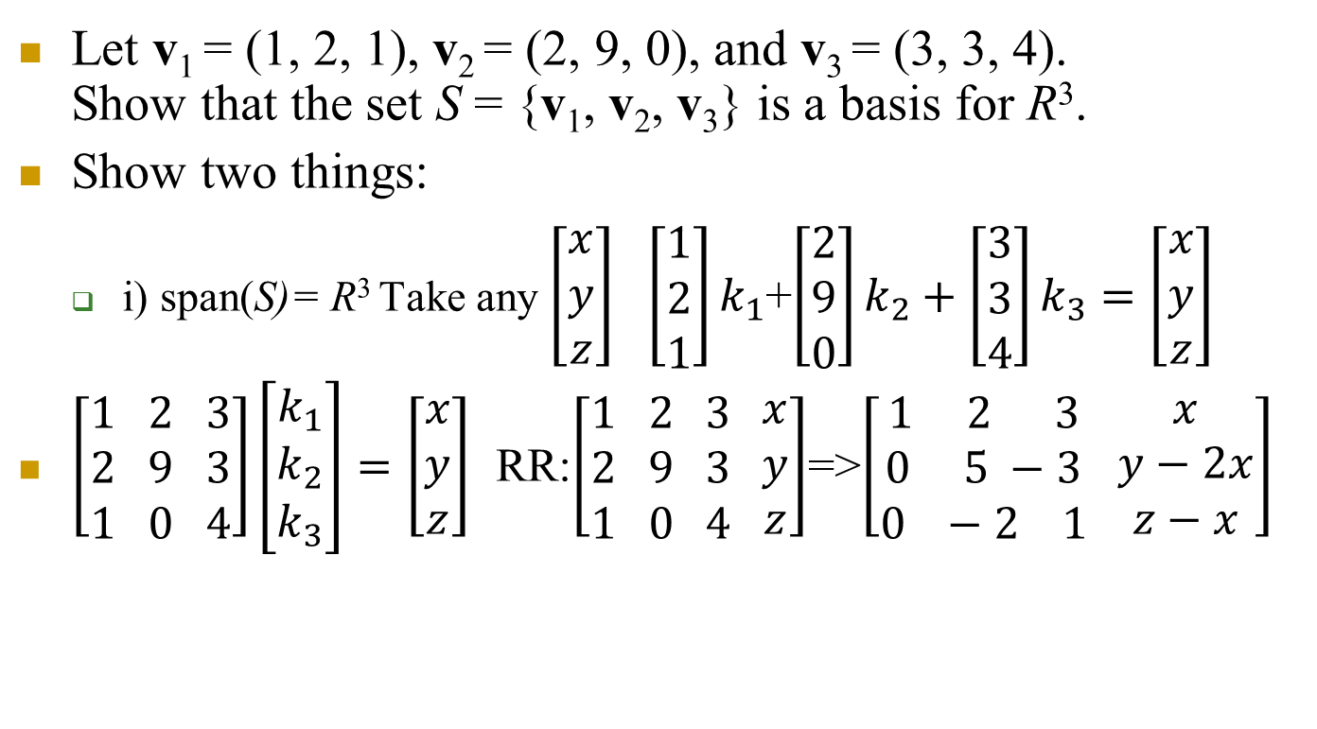
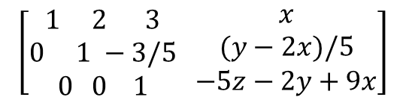
5-4 Example 3
Let v₁ = (1, 2, 1), v₂ = (2, 9, 0), and v₃ = (3, 3, 4). Show that the set S = {v₁, v₂, v₃} is a basis for R³.
Show two things:
i) span(S)= R³ Take any $\left[\begin{aligned}x \\ y \\ z\end{aligned}\right]$ $\left[\begin{aligned}1 \\ 2 \\ 1\end{aligned}\right]k_{1}$+$\left[\begin{aligned}2 \\ 9 \\ 0\end{aligned}\right]k_{2}+\left[\begin{aligned}3 \\ 3 \\ 4\end{aligned}\right]k_{3}=\left[\begin{aligned}x \\ y \\ z\end{aligned}\right]$
$\left[\begin{aligned}1 2 3 \\ 2 9 3 \\ 1 0 4\end{aligned}\right]\left[\begin{aligned}k_{1} \\ k_{2} \\ k_{3}\end{aligned}\right]=\left[\begin{aligned}x \\ y \\ z\end{aligned}\right]$ RR:$\left[\begin{aligned}1 2 3 \\ 2 9 3 \\ 1 0 4\end{aligned} \begin{aligned}x \\ y \\ z\end{aligned}\right]$=>$\left[\begin{aligned}1 2 3 \\ 0 5 −3 \\ 0 −2 1\end{aligned} \begin{aligned}x \\ y−2x \\ z−x\end{aligned}\right]$
$$\left[\begin{aligned}1 2 3 \\ 0 1 −3/5 \\ 0 0 1\end{aligned} \begin{aligned}x \\ (y−2x)/5 \\ −5z−2y+9x\end{aligned}\right]$$
Can solve for the constants in terms
of x,y,z.

Slide 60



Example 3 cont.
The vectors in the set are independent. Similarly
is satisfied by nontrivial $k_{i}$ (all necessarily zero). To see this note that the previous general system gives us
$$\left[\begin{aligned}1 2 3 \\ 2 9 3 \\ 1 0 4\end{aligned}\right]\left[\begin{aligned}k_{1} \\ k_{2} \\ k_{3}\end{aligned}\right]=\left[\begin{aligned}0 \\ 0 \\ 0\end{aligned}\right]$$
$$\left[\begin{aligned}1 2 3 \\ 0 1 −3/5 \\ 0 0 1\end{aligned} \begin{aligned}0 \\ 0 \\ 0\end{aligned}\right]$$

Slide 61


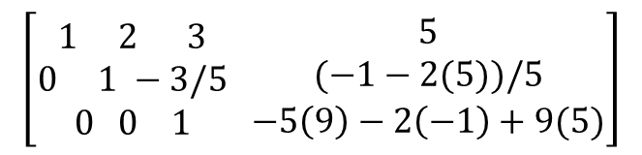
5-4 Example 4 (Representing a Vector Using Two Bases)
Let S = {v₁, v₂, v₃} be the basis for R³ in the preceding example.
Find the coordinate vector of v = (5, -1, 9) with respect to S.
Again using the previous general result, we get
=>
$$\left[\begin{aligned}1 2 3 \\ 2 9 3 \\ 1 0 4\end{aligned}\right]\left[\begin{aligned}k_{1} \\ k_{2} \\ k_{3}\end{aligned}\right]=\left[\begin{aligned}5 \\ −1 \\ 9\end{aligned}\right]$$
$$\left[\begin{aligned}1 2 3 \\ 0 1 −3/5 \\ 0 0 1\end{aligned} \begin{aligned}5 \\ (−1−2(5))/5 \\ −5\left(9\right)−2\left(−1\right)+9(5)\end{aligned}\right]$$
$$\left[\begin{aligned}1 2 3 \\ 0 1 −3/5 \\ 0 0 1 \end{aligned} \begin{aligned} 5 \\ −11/5 \\ 2\end{aligned}\right]$$
Solving by back substitution we get Z=2, y=-1, x=1
Can of course use other methods to solve this system

Slide 62
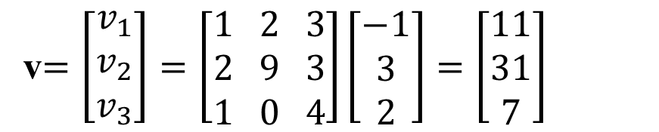
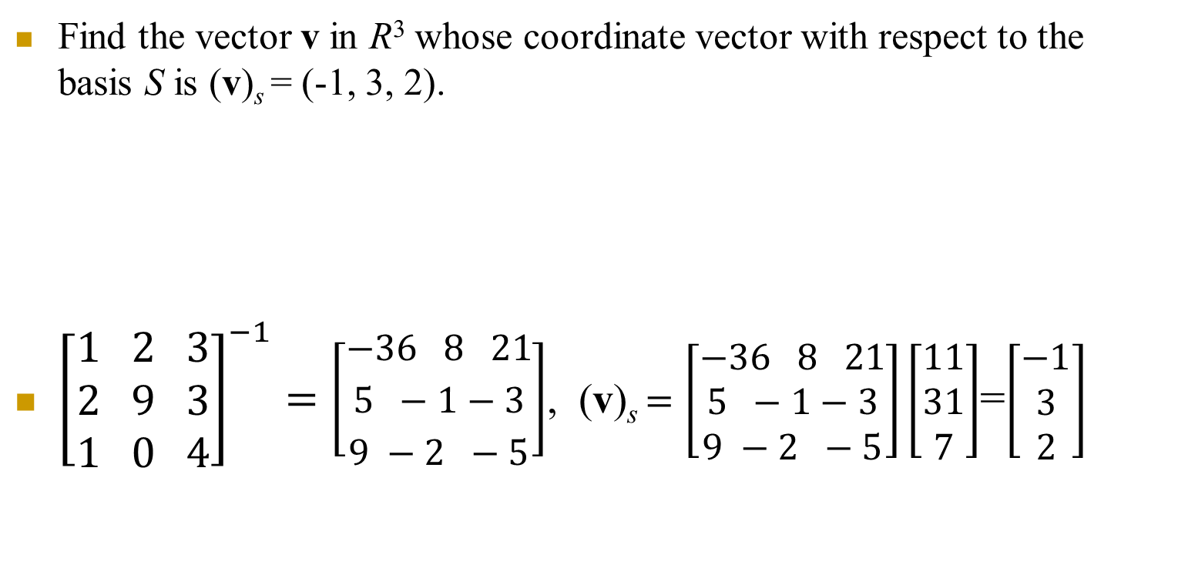
Example 4 cont.
Find the vector v in R³ whose coordinate vector with respect to the basis S is (v)_{s} = (-1, 3, 2).
${\left[\begin{aligned}1 2 3 \\ 2 9 3 \\ 1 0 4\end{aligned}\right]}^{−1}=\left[\begin{aligned}−36 8 21 \\ 5 −1−3 \\ 9 −2 −5\end{aligned}\right]$, (v)_{s} $=\left[\begin{aligned}−36 8 21 \\ 5 −1−3 \\ 9 −2 −5\end{aligned}\right]\left[\begin{aligned}11 \\ 31 \\ 7\end{aligned}\right]$=$\left[\begin{aligned}−1 \\ 3 \\ 2\end{aligned}\right]$
v$=\left[\begin{aligned}v_{1} \\ v_{2} \\ v_{3}\end{aligned}\right]=\left[\begin{aligned}1 2 3 \\ 2 9 3 \\ 1 0 4\end{aligned}\right]\left[\begin{aligned}−1 \\ 3 \\ 2\end{aligned}\right]=\left[\begin{aligned}11 \\ 31 \\ 7\end{aligned}\right]$
(v)_{s}
v

Slide 63
5-4 Example 5(Standard Basis for P^{n})
S = {1, x, x², …, x^{n}} is a basis for the vector space P_{n} of polynomials of the form a₀ + a₁x + … + a_{n}x^{n}. The set S is called the standard basis for P_{n}. Find the coordinate vector of the polynomial p = a₀ + a₁x + a₂x² relative to the basis S = {1, x, x²} for P₂ .
Solution:
The coordinates of p = a₀ + a₁x + a₂x² are the scalar coefficients of the basis vectors 1, x, and x², so
(p)_{s}=(a₀, a₁, a₂).

Slide 64
Example 5 extended (to be completed by you!)
Find the coordinate vector of the polynomial p = a₀ + a₁x + a₂x² relative to the basis S = {1+x, x- x², 1-x²} for P₂ .
a₀ + a₁x + a₂x²= (p)_{s1}(1+x)+ (p)_{s2}(x- x²)+ (p)_{s3}(1- x²)
Write three equations
Represent by a linear system with three eqn. in three unknowns
Solve for the unknowns (coordinates (p)_{si})

Slide 65
5-4 Example 6 (Standard Basis for M_{mn})
Let
The set S = {M₁, M₂, M₃, M₄} is a basis for the vector space M₂₂ of 2×2 matrices.
To see that S spans M₂₂, note that an arbitrary vector (matrix) can be written as
To see that S is linearly independent, assume aM₁ + bM₂ + cM₃ + dM₄ = 0. It follows that . Thus, a = b = c = d = 0, so S is lin. indep.

Slide 66
5-4 Example 7 (Basis for the Subspace span(S))
If S = {v₁, v₂, …,v_{n}} is a linearly independent set in a vector space V, then S is a basis for the subspace span(S) since the set S span span(S) by definition of span(S).
Any vector in span(S) is a linear combination of {v₁, v₂, …,v_{n}}

Slide 67
5-4 Finite-Dimensional
A nonzero vector space V is called finite-dimensional
if it contains a finite set of vectors {v₁, v₂, …,v_{n}} that forms a basis.
If no such set exists, V is called infinite-dimensional.
In addition, we shall regard the zero vector space to be finite-dimensional.
Example 8
The vector spaces R^{n}, P_{n}, and M_{mn} are finite-dimensional.
The vector spaces F(-∞, ∞), C(- ∞, ∞), C^{m}(- ∞, ∞), and C∞(- ∞, ∞) are infinite-dimensional.

Slide 68
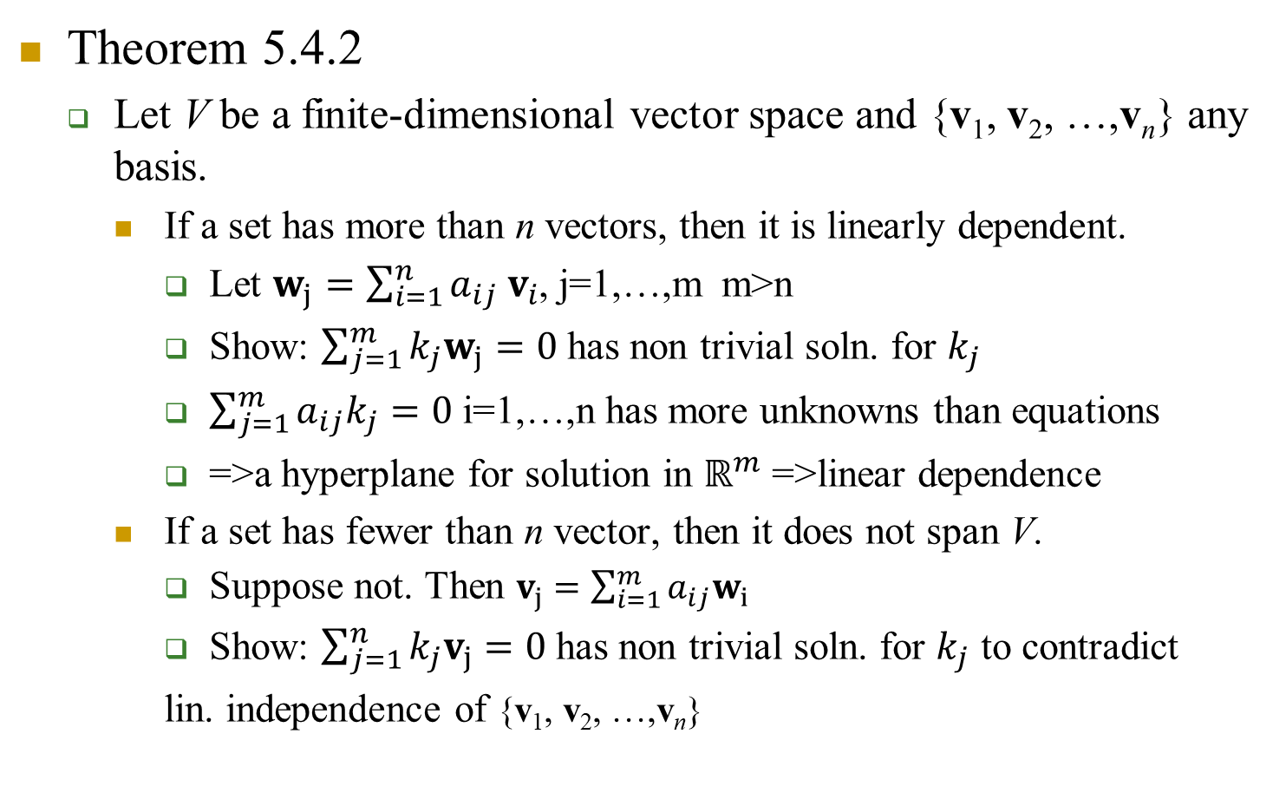
Theorem 5.4.2 & 5.4.3
Theorem 5.4.2
Let V be a finite-dimensional vector space and {v₁, v₂, …,v_{n}} any basis.
If a set has more than n vectors, then it is linearly dependent.
Let $w_{j}=\sum_{i=1}^{n}{a_{ij} v_{i}}$, j=1,…,m m>n
Show: $\sum_{j=1}^{m}{k_{j}w_{j}}=0$ has non trivial soln. for $k_{j}$
$\sum_{j=1}^{m}{a_{ij}k_{j}}=0$ i=1,…,n has more unknowns than equations
=>a hyperplane for solution in $ℝ^{m}$ =>linear dependence
If a set has fewer than n vector, then it does not span V.
Suppose not. Then $v_{j}=\sum_{i=1}^{m}{a_{ij}w_{i}}$
Show: $\sum_{j=1}^{n}{k_{j}v_{j}}=0$ has non trivial soln. for $k_{j}$ to contradict
lin. independence of {v₁, v₂, …,v_{n}}

Slide 69
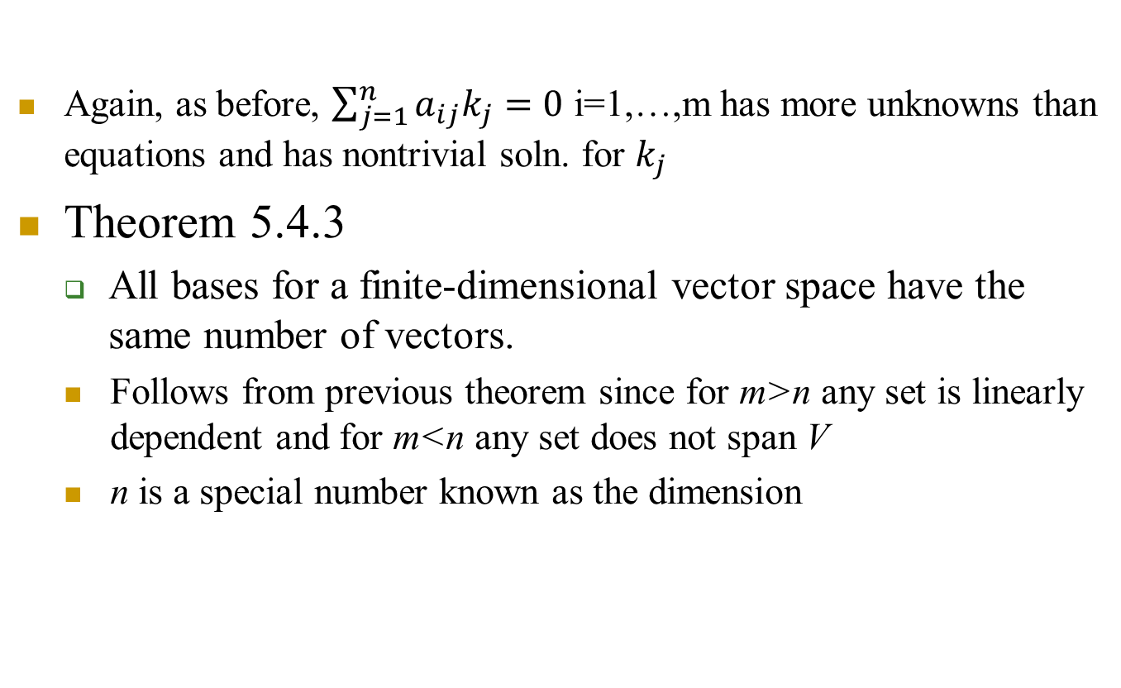
Theorem 5.4.2 & 5.4.3 cont.
Again, as before, $\sum_{j=1}^{n}{a_{ij}k_{j}}=0$ i=1,…,m has more unknowns than equations and has nontrivial soln. for $k_{j}$
Theorem 5.4.3
All bases for a finite-dimensional vector space have the same number of vectors.
Follows from previous theorem since for m>n any set is linearly dependent and for m<n any set does not span V
n is a special number known as the dimension

Slide 70
5-4 Dimension
The dimension of a finite-dimensional vector space V, denoted by dim(V), is defined to be the number of vectors in a basis for V.
We define the zero vector space to have dimension zero.
Dimensions of Some Vector Spaces:
dim(R^{n}) = n [The standard basis has n vectors]
dim(P_{n}) = n + 1 [The standard basis has n + 1 vectors]
dim(M_{mn}) = mn [The standard basis has mn vectors]

Slide 71
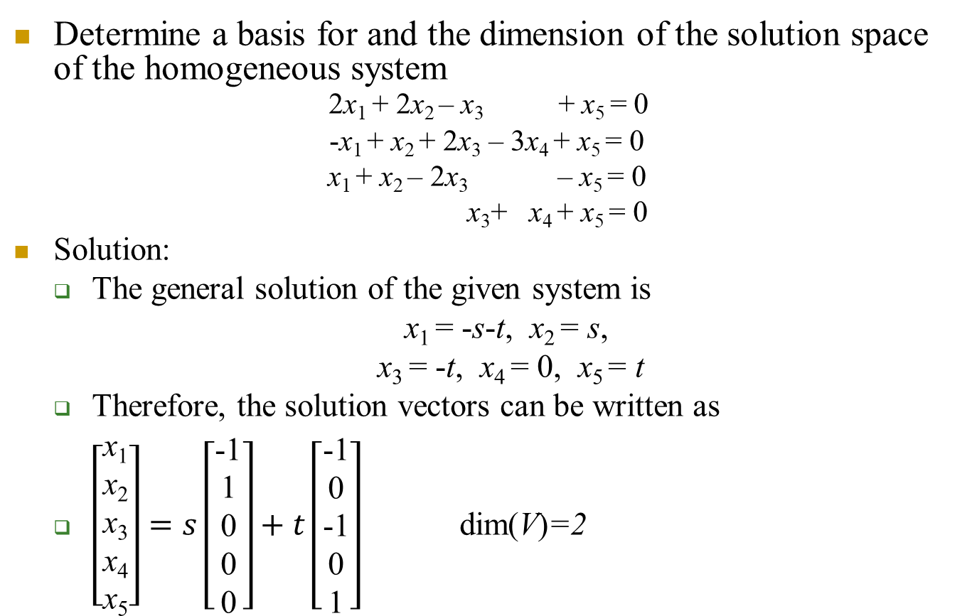
5-4 Example 10
Determine a basis for and the dimension of the solution space of the homogeneous system 2x₁ + 2x₂ – x₃ + x₅ = 0
-x₁ + x₂ + 2x₃ – 3x₄ + x₅ = 0
x₁ + x₂ – 2x₃ – x₅ = 0
x₃+ x₄ + x₅ = 0
Solution:
The general solution of the given system is
x₁ = -s-t, x₂ = s,
x₃ = -t, x₄ = 0, x₅ = t
Therefore, the solution vectors can be written as
$\left[\begin{aligned}\text{x}\text{1} \\ \text{x}\text{2} \\ \text{x}\text{3} \\ \text{x}\text{4} \\ \text{x}\text{5}\end{aligned}\right]=s\left[\begin{aligned}\text{−1} \\ \text{1} \\ \text{0} \\ \text{0} \\ \text{0}\end{aligned}\right]+t\left[\begin{aligned}\text{−1} \\ \text{0} \\ \text{−1} \\ \text{0} \\ \text{1}\end{aligned}\right]$ dim(V)=2
v₁ v₂

Slide 72
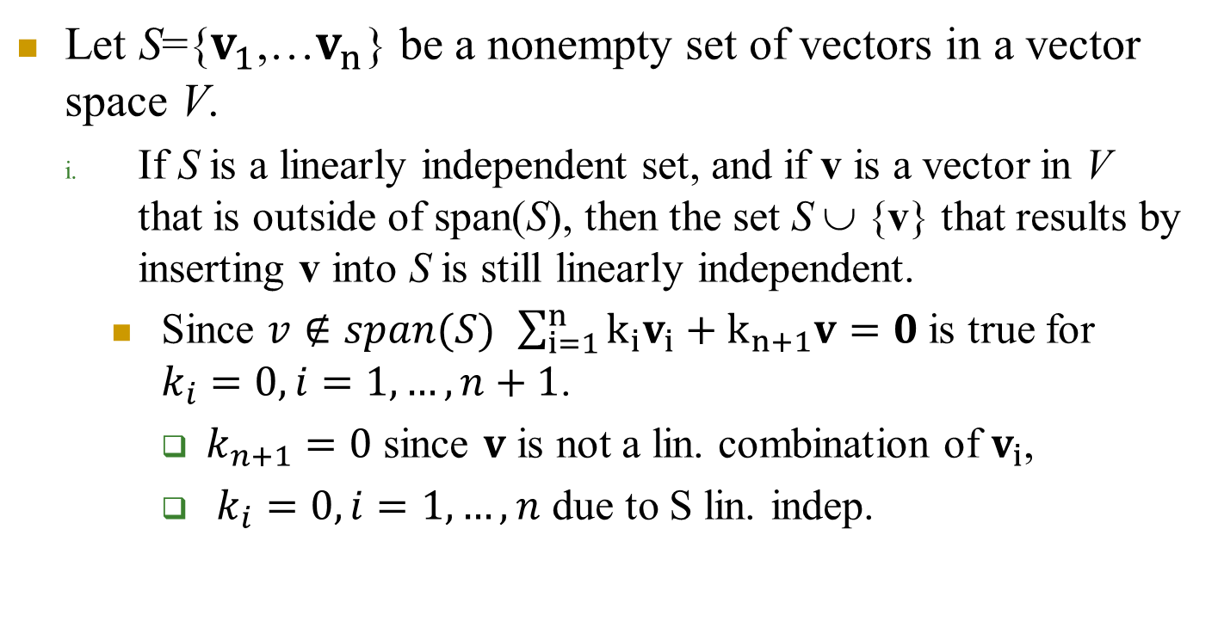
Theorem 5.4.4 (Plus/Minus Theorem)
Let S={$v_{1}$,…$v_{n}$} be a nonempty set of vectors in a vector space V.
If S is a linearly independent set, and if v is a vector in V that is outside of span(S), then the set S ∪ {v} that results by inserting v into S is still linearly independent.
Since $v∉span(S)$ $\sum_{i=1}^{n}{{k_{i}v}_{i}}+k_{n+1}v=0$is true for $k_{i}=0, i=1,…,n+1$.
$k_{n+1}=0$ since $v$ is not a lin. combination of $v_{i}$,
$k_{i}=0, i=1,…,n$ due to S lin. indep.

Slide 73
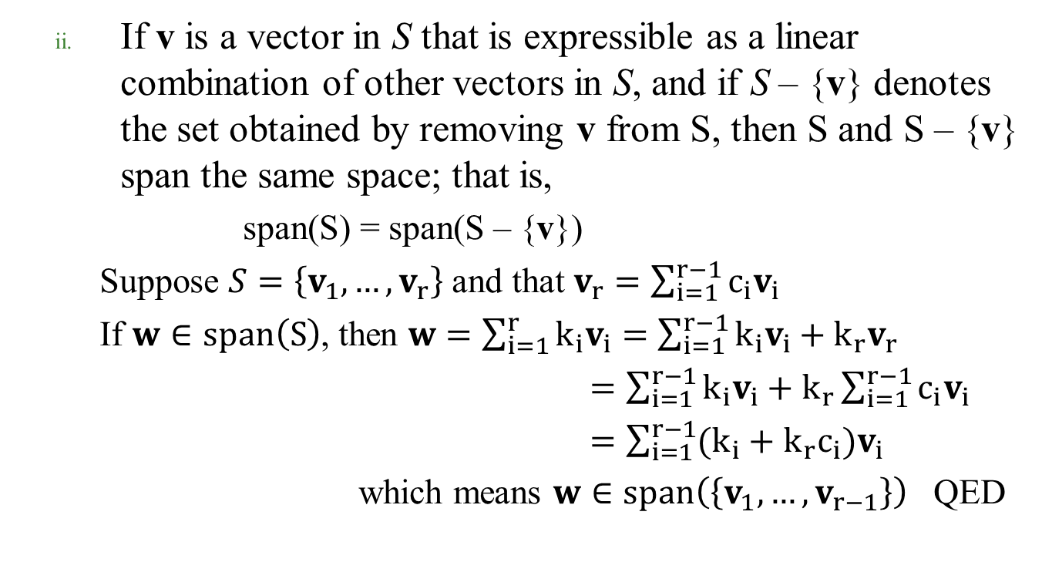
If v is a vector in S that is expressible as a linear combination of other vectors in S, and if S – {v} denotes the set obtained by removing v from S, then S and S – {v} span the same space; that is,
span(S) = span(S – {v})
Suppose $S=\left\{v_{1},…,v_{r}\right\}$ and that $v_{r}=\sum_{i=1}^{r−1}{c_{i}v_{i}}$
If $w∈span\left(S\right)$, then $w=\sum_{i=1}^{r}{k_{i}v_{i}}=\sum_{i=1}^{r−1}{k_{i}v_{i}}+k_{r}v_{r}$
$=\sum_{i=1}^{r−1}{k_{i}v_{i}}+k_{r}\sum_{i=1}^{r−1}{c_{i}v_{i}}$
$=\sum_{i=1}^{r−1}{(k_{i}+k_{r}c_{i})v_{i}}$
which means $w∈span\left(\left\{v_{1},…,v_{r−1}\right\}\right)$ QED

Slide 74
Theorem 5.4.5
If V is an n-dimensional vector space, and if S is a set in V with exactly n vectors
then S is a basis for V if either S spans V or S is linearly independent.
Suppose S spans V. If S is not linearly independent, we can remove a vector from S which is a linear combination of other n-1 vectors and the remaining set of n-1 vectors still spans V. However spanning n-dimensional vector space with fewer than n vectors is impossible. Thus, S is linearly independent.
Suppose S has n linearly independent vectors. If these vectors do not span V, we can add to S a vector not in the span of S, so that the newly formed set is linearly independent. However, it is impossible to have n+1 linearly independent vectors in an n dimensional vector space. Thus S spans V.

Slide 75
5-4 Example 11
Show that v₁ = (-3, 7) and v₂ = (5, 5) form a basis for R² by inspection.
Solution:
Neither vector is a scalar multiple of the other ⇒ The two vectors form a linear independent set in the 2-D space R² ⇒ The two vectors form a basis by Theorem 5.4.5.
Show that v₁ = (2, 0, 1) , v₂ = (4, 0, 7), v₃ = (-1, 1, 4) form a basis for R³ by inspection.
v₁, v₂ form a linearly independent set that spans x-z plane. v₃ is not in the span of v₁, v₂ . Thus, the three vectors are linearly independent. Thus, the three of them span a 3-dimensional vector space, the R³, which they reside in.

Slide 76
Theorem 5.4.6
Let S be a finite set of vectors in a finite-dimensional vector space V.
If S spans V but is not a basis for V, then S can be reduced to a basis for V by removing appropriate vectors from S
S is not a linearly independent set and can iteratively remove linearly dependent vectors from S without changing the span until the remaing vectors are linearly independent.
If S is a linearly independent set that is not already a basis for V, then S can be enlarged to a basis for V by inserting appropriate vectors into S
Span of S is not V, hence can find and add iteratively to S those vectors not in the span of the grown set until the grown linearly independent set spans V (no. vectors equals dim(V)).

Slide 77
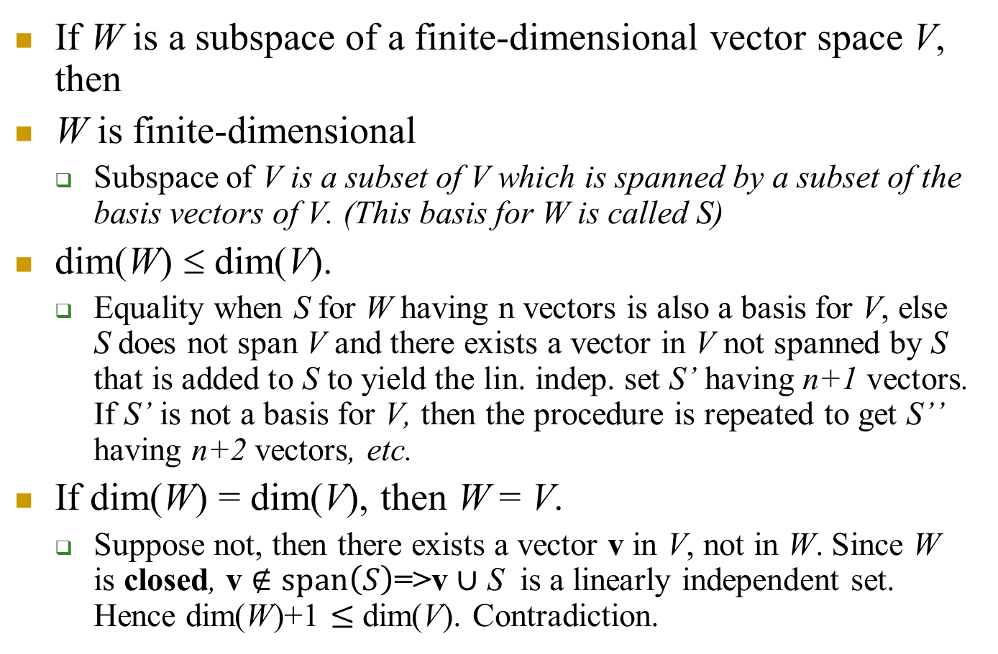
Theorem 5.4.7
If W is a subspace of a finite-dimensional vector space V, then
W is finite-dimensional
Subspace of V is a subset of V which is spanned by a subset of the basis vectors of V. (This basis for W is called S)
dim(W) ≤ dim(V).
Equality when S for W having n vectors is also a basis for V, else S does not span V and there exists a vector in V not spanned by S that is added to S to yield the lin. indep. set S’ having n+1 vectors. If S’ is not a basis for V, then the procedure is repeated to get S’’ having n+2 vectors, etc.
If dim(W) = dim(V), then W = V.
Suppose not, then there exists a vector v in V, not in W. Since W is closed, v $∉span\left(S\right)$=>v $∪$ S is a linearly independent set. Hence dim(W)+1 $≤$ dim(V). Contradiction.

Slide 78
Chapter Content
Real Vector Spaces
Subspaces
Linear Independence
Basis and Dimension
Row Space, Column Space, and Nullspace
Rank and Nullity

Slide 79
5-5 Definition
For an m×n matrix the vectors
in R^{n} form the rows of A called the row vectors of A, and the vectors in R^{m} form the columns of A called the column vectors of A.

Slide 80
5-5 Example 1
Let
The row vectors of A are
r₁ = [2 1 0] and r₂ = [3 -1 4]
and the column vectors of A are

Slide 81
5-5 Row Space, Column Space, Nullspace
If A is an m×n matrix
the subspace of R^{n} spanned by the row vectors of A is called the row space of A
the subspace of R^{m} spanned by the column vectors is called the column space of A
The solution space of the homogeneous system of equation Ax = 0, which is a subspace of R^{n}, is called the nullspace of A.

Slide 82

Theorem 5.5.1
A system of linear equations Ax = b is consistent
if and only if b is in the column space of A.
$Ax=x_{1}c_{1}+x_{2}c_{2}+…+x_{n}c_{n}=\text{b}$ having a solution for $x_{i}$ means that
$\text{b}∈span(\{c_{1},c_{2},…,c_{n}$})

Slide 83
5-5 Example 2
Let Ax = b be the linear system Show that b is in the column space of A, and express b as a linear combination of the column vectors of A.
Solution:
Solving the system by Gaussian elimination yields
x₁ = 2, x₂ = -1, x₃ = 3
Since the system is consistent, b is in the column space of A.
Moreover, it follows that:
which means b can be
expressed as a linear
combination of column vectors

Slide 84
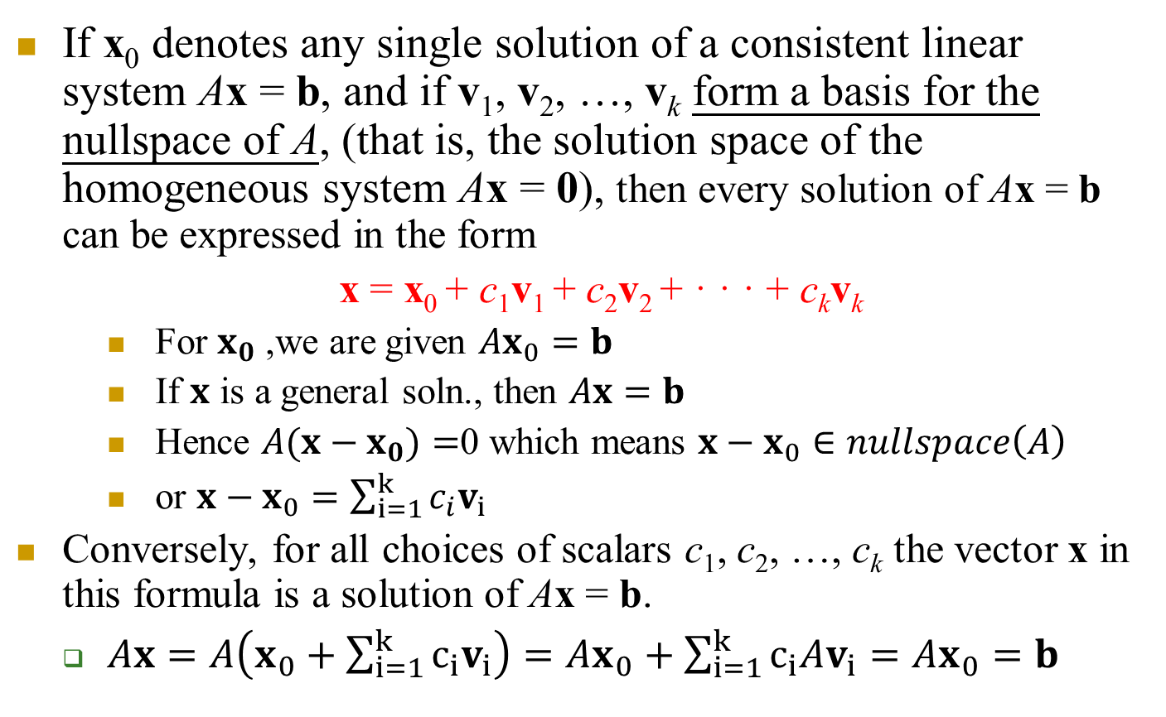
Theorem 5.5.2
If x₀ denotes any single solution of a consistent linear system Ax = b, and if v₁, v₂, …, v_{k} form a basis for the nullspace of A, (that is, the solution space of the homogeneous system Ax = 0), then every solution of Ax = b can be expressed in the form
x = x₀ + c₁v₁ + c₂v₂ + · · · + c_{k}v_{k}
For $x_{0}$,we are given $Ax_{0}=b$
If $x$ is a general soln., then $Ax=b$
Hence $A(x−x_{0})=$0 which means $x−x_{0}∈nullspace\left(A\right)$
or $x−x_{0}=\sum_{i=1}^{k}{c_{i}v_{i}}$
Conversely, for all choices of scalars c₁, c₂, …, c_{k} the vector x in this formula is a solution of Ax = b.
$Ax=A\left(x_{0}+\sum_{i=1}^{k}{c_{i}v_{i}}\right)=Ax_{0}+\sum_{i=1}^{k}{c_{i}Av_{i}}=Ax_{0}=b$

Slide 85



Geometric interpretation
$$x_{0}$$
$$v_{2}$$
$$v_{1}$$
$$x$$

Slide 86
5-5 General and Particular Solutions
Remark
The vector x₀ is called a particular solution of Ax = b
The expression x₀ + c₁v₁ + · · · + c_{k}v_{k} is called the general solution of Ax = b
The expression c₁v₁ + · · · + c_{k}v_{k} is called the general solution of Ax = 0
The general solution of Ax = b
the sum of any particular solution of Ax = b and the general solution of Ax = 0

Slide 87
5-5 Example 3 (General Solution of Ax = b)
The solution to the nonhomogeneous system
x₁ + 3x₂ – 2x₃ + 2x₅ = 0
2x₁ + 6x₂ – 5x₃ – 2x₄ + 4x₅ – 3x₆ = -1
5x₃ + 10x₄ + 15x₆ = 5
2x₁ + 5x₂ + 8x₄ + 4x₅ + 18x₆ = 6
is
x₁ = -3r - 4s - 2t, x₂ = r, x₃ = -2s, x₄ = s, x₅ = t, x₆ = 1/3
The result can be written in vector form as
which is the general solution.
The vector x₀ is a particular solution of nonhomogeneous system, and the linear combination x’ is the general solution of the homogeneous system.
x’

Slide 88
Theorem 5.5.3 & 5.5.4
Elementary row operations do not change the nullspace of a matrix
Elementary row operations do not change the solution set of a linear system, in particular of the form Ax = 0
Elementary row operations do not change the row space of a matrix.
Row interchange has no effect on linear combination of rows, multiplication by a factor or multiply add are simple linear combinations and linear combination of a linear combination is a linear combination.
Elementary row operations might change the column space of a matrix.

Slide 89

Elementary row operations and column space
Ex:$A=\left[\begin{aligned}1 2 \\ 1 2\end{aligned}\right]$ subtract first row from second.
Column space is a line through origin that changes direction $\left[\begin{aligned}1 \\ 1\end{aligned}\right]$ to direction $\left[\begin{aligned}1 \\ 0\end{aligned}\right]$ after subtraction operation

Slide 90
5-5 Example 4
Find a basis for the nullspace of
Solution
The nullspace of A is the solution space of the homogeneous system
2x₁ + 2x₂ – x₃ + x₅ = 0
-x₁ – x₂ – 2 x₃ – 3x₄ + x₅ = 0
x₁ + x₂ – 2 x₃ – x₅ = 0
x₃ + x₄ + x₅ = 0
In Example 10 of Section 5.4 we showed that the vectors form a basis for the nullspace.

Slide 91
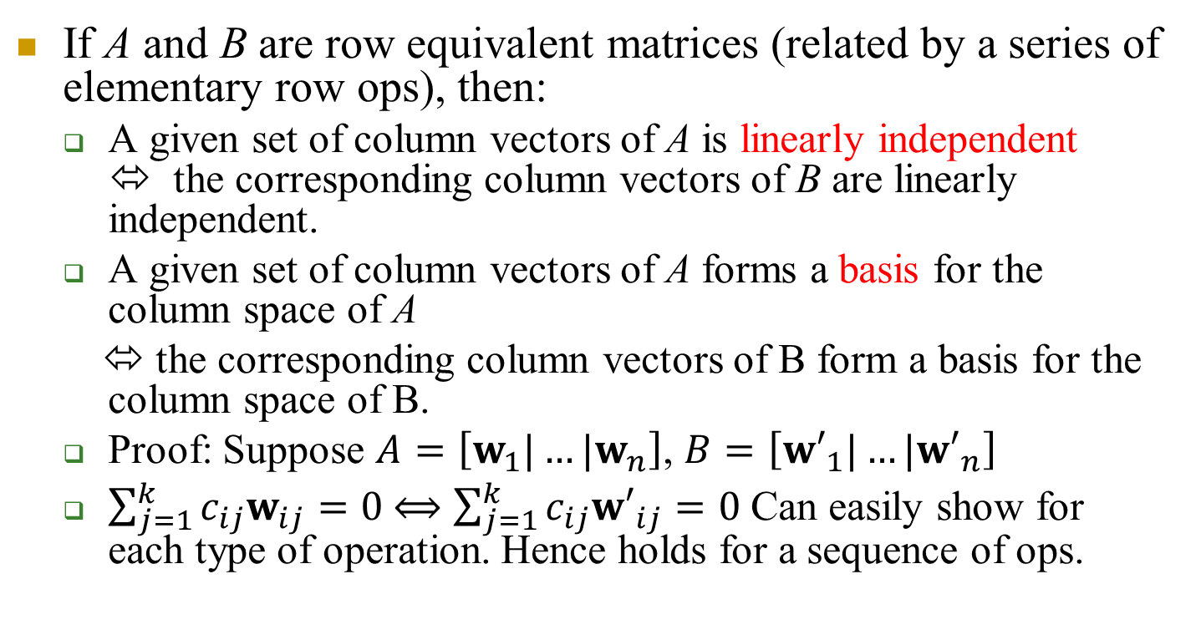
Theorem 5.5.5
If A and B are row equivalent matrices (related by a series of elementary row ops), then:
A given set of column vectors of A is linearly independent ⬄ the corresponding column vectors of B are linearly independent.
A given set of column vectors of A forms a basis for the column space of A
⬄ the corresponding column vectors of B form a basis for the column space of B.
Proof: Suppose $A=\left[w_{1}|…|w_{n}\right]$, $B=\left[{w′}_{1}|…|{w′}_{n}\right]$
$\sum_{j=1}^{k}{c_{ij}w_{ij}}=0$ $⟺$ $\sum_{j=1}^{k}{c_{ij}{w′}_{ij}}=0$ Can easily show for each type of operation. Hence holds for a sequence of ops.

Slide 92
Theorem 5.5.6
If a matrix R is in row echelon form
the row vectors with the leading 1’s (i.e., the nonzero row vectors) form a basis for the row space of R
Can easily get a basis for the row space of an arbitrary matrix A by applying elementary row ops and using the basis for resultant matrix R since ops do not change the row space
the column vectors with the leading 1’s of the row vectors form a basis for the column space of R
By the previous theorem, a basis for the column space of A is the column vectors of A that correspond to the column vectors of R with the leading 1’s of the row vectors.

Slide 93
5-5 Example 5

Slide 94
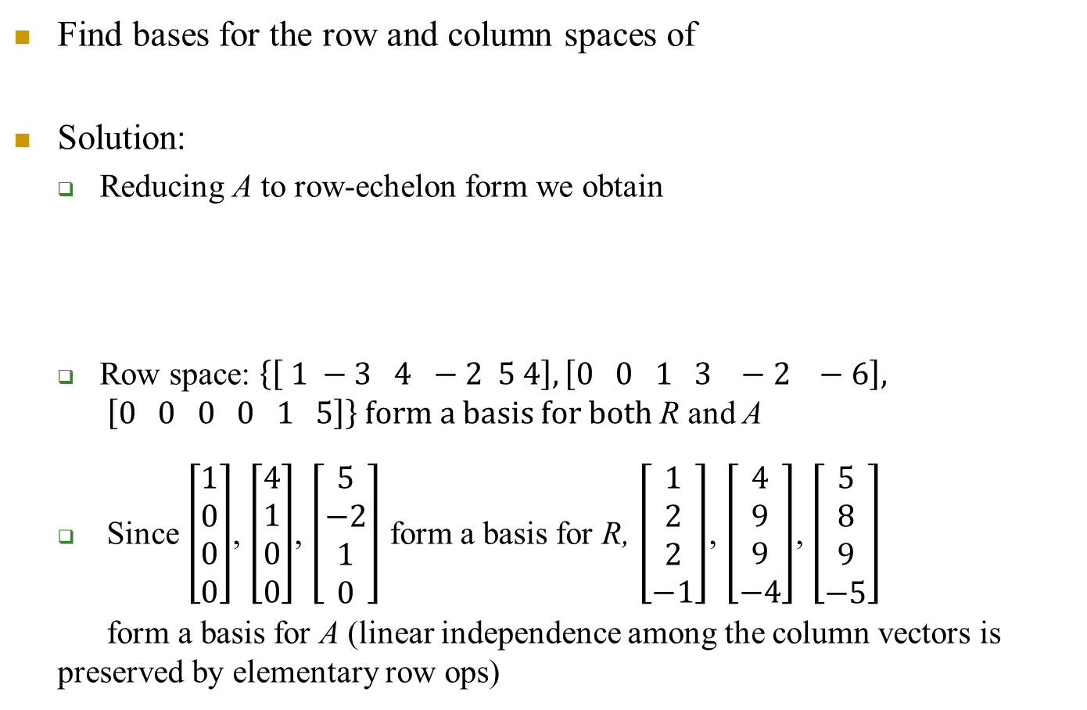
5-5 Example 6
Find bases for the row and column spaces of
Solution:
Reducing A to row-echelon form we obtain
Row space: $\left\{\left[ 1 −3 4 −2 5 4\right], \left[0 0 1 3 −2 −6\right], \left[0 0 0 0 1 5\right]\right\}$ form a basis for both R and A
Since $\left[\begin{aligned}1 \\ 0 \\ 0 \\ 0\end{aligned}\right]$, $\left[\begin{aligned}4 \\ 1 \\ 0 \\ 0\end{aligned}\right]$, $\left[\begin{aligned}5 \\ −2 \\ 1 \\ 0\end{aligned}\right]$ form a basis for R, $\left[\begin{aligned}1 \\ 2 \\ 2 \\ −1\end{aligned}\right]$, $\left[\begin{aligned}4 \\ 9 \\ 9 \\ −4\end{aligned}\right]$, $\left[\begin{aligned}5 \\ 8 \\ 9 \\ −5\end{aligned}\right]$
form a basis for A (linear independence among the column vectors is preserved by elementary row ops)
Note the correspondence!

Slide 95

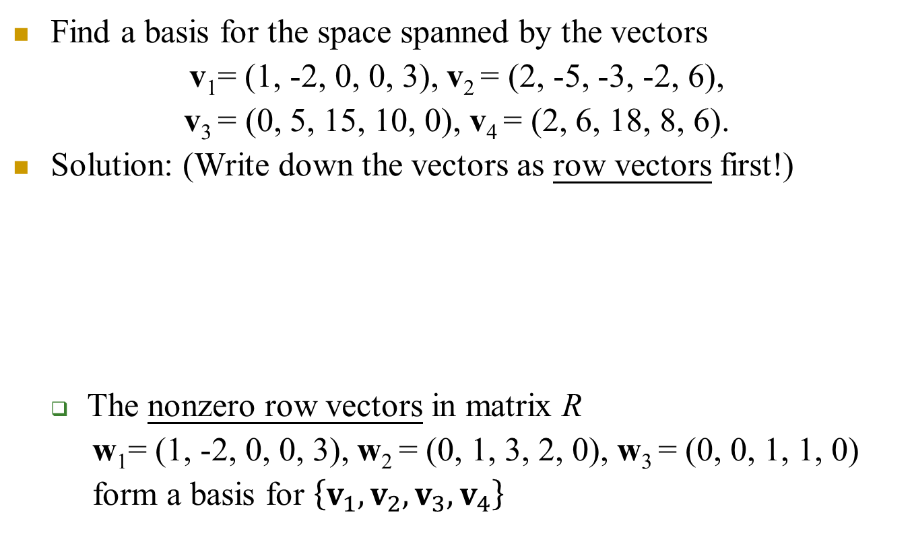

5-5 Example 7 (Basis for a Vector Space Using Row Operations )
Find a basis for the space spanned by the vectors
v₁= (1, -2, 0, 0, 3), v₂ = (2, -5, -3, -2, 6),
v₃ = (0, 5, 15, 10, 0), v₄ = (2, 6, 18, 8, 6).
Solution: (Write down the vectors as row vectors first!)
The nonzero row vectors in matrix R
w₁= (1, -2, 0, 0, 3), w₂ = (0, 1, 3, 2, 0), w₃ = (0, 0, 1, 1, 0)
form a basis for $\left\{v_{1},v_{2},v_{3},v_{4}\right\}$
Elem
row
ops
$$A=$$
R$=$

Slide 96
5-5 Remarks
Keeping in mind that A and R may have different column spaces, we cannot find a basis for the column space of A directly from the column vectors of R.
However, it follows from Theorem 5.5.5b that if we can find a set of column vectors of R that forms a basis for the column space of R, then the corresponding column vectors of A will form a basis for the column space of A.
In the previous example, the basis vectors obtained for the column space of A consisted of column vectors of A, but the basis vectors obtained for the row space of A were not all vectors of A.
Transpose of the matrix can be used to solve this problem.

Slide 97
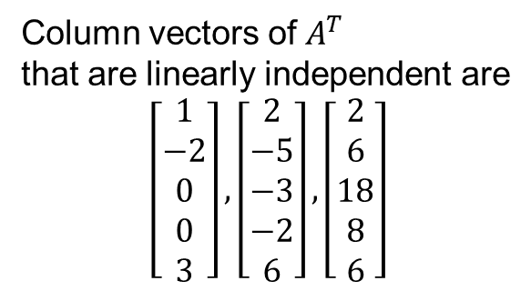
5-5 Example 8 (Basis for the Row Space of a Matrix )
Find a basis for the row space of consisting entirely of row vectors from A.
Solution:
Column vectors of $A^{T}$
that are linearly independent are
$$\left[\begin{aligned}1 \\ −2 \\ 0 \\ 0 \\ 3\end{aligned}\right],\left[\begin{aligned}2 \\ −5 \\ −3 \\ −2 \\ 6\end{aligned}\right], \left[\begin{aligned}2 \\ 6 \\ 18 \\ 8 \\ 6\end{aligned}\right]$$

Slide 98
5-5 Example 9 (Basis and Linear Combinations )
(a) Find a subset of the vectors v₁ = (1, -2, 0, 3), v₂ = (2, -5, -3, 6), v₃ = (0, 1, 3, 0), v₄ = (2, -1, 4, -7), v₅ = (5, -8, 1, 2) that forms a basis for the space spanned by these vectors.
Solution (a):
Thus, {v₁, v₂, v₄} is a basis for the column space of the matrix.

Slide 99
5-5 Example 9
(b) Express each vector not in the basis as a linear combination of the basis vectors.
Solution (b):
express w₃ as a linear combination of w₁ and w₂,
express w₅ as a linear combination of w₁, w₂, and w₄
w₃ = 2w₁ – w₂
w₅ = w₁ + w₂ + w₄
We call these the dependency equations. The corresponding relationships in the original vectors are
v₃ = 2v₁ – v₂
v₃ = v₁ + v₂ + v₄
Note that dependency equations are preserved under elem row ops

Slide 100
Chapter Content
Real Vector Spaces
Subspaces
Linear Independence
Basis and Dimension
Row Space, Column Space, and Nullspace
Rank and Nullity

Slide 101
5-6 Four Fundamental Matrix Spaces
Consider a matrix A and its transpose A^{T} together, then there are six vector spaces of interest:
row space of A, row space of A^{T}
column space of A, column space of A^{T}
null space of A, null space of A^{T}
However, the fundamental matrix spaces associated with A are
row space of A, column space of A
null space of A, null space of A^{T}
(The other two are redundant)

Slide 102
5-6 Four Fundamental Matrix Spaces
If A is an m×n matrix
the row space of A and nullspace of A are subspaces of R^{n}
Basis vectors have n components
the column space of A and the nullspace of A^{T} are subspace of R^{m}
Basis vectors have m components
What is the relationship between the dimensions of these four vector spaces?

Slide 103
5-6 Dimension and Rank
Theorem 5.6.1
If A is any matrix, then the row space and column space of A have the same dimension.
Remember dim. of a space is the no. (independent) basis vectors for it. In this case, this corresponds to the number of leading 1’s.
Definition
The common dimension of the row and column space of a matrix A is called the rank of A and is denoted by rank(A).
The dimension of the nullspace of a is called the nullity of A and is denoted by nullity(A).

Slide 104
5-6 Example 1 (Rank and Nullity)
Find the rank and nullity of the matrix
Solution:
The reduced row-echelon form of A is
Since there are two nonzero rows (two leading 1’s), the row space and column space are both two-dimensional, so rank(A) = 2.

Slide 105
5-6 Example 1 (Rank and Nullity)
The corresponding system of equations for the system Ax=0 will be
x₁ – 4x₃ – 28x₄ – 37x₅ + 13x₆ = 0
x₂ – 2x₃ – 12x₄ – 16 x₅+ 5 x₆ = 0
It follows that the general solution of the system is
x₁ = 4r + 28s + 37t – 13u, x₂ = 2r + 12s + 16t – 5u,
x₃ = r, x₄ = s, x₅ = t, x₆ = u
or
Thus, nullity(A) = 4.
Basis vectors for the soln. space of Ax=0

Slide 106
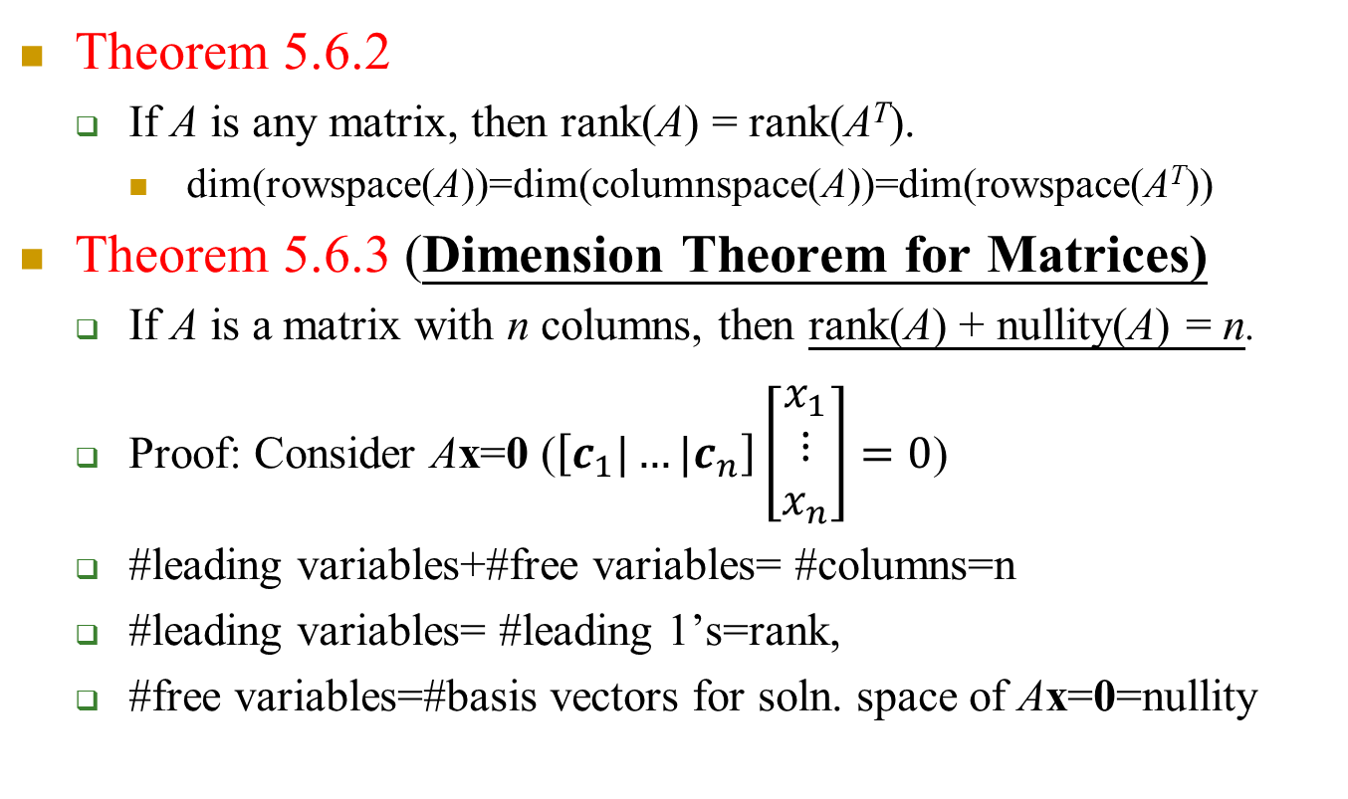
5-6 Theorems
Theorem 5.6.2
If A is any matrix, then rank(A) = rank(A^{T}).
dim(rowspace(A))=dim(columnspace(A))=dim(rowspace(A^{T}))
Theorem 5.6.3 (Dimension Theorem for Matrices)
If A is a matrix with n columns, then rank(A) + nullity(A) = n.
Proof: Consider Ax=0 ($\left[c_{1}|…|c_{n}\right]\left[\begin{aligned}x_{1} \\ ⋮ \\ x_{n}\end{aligned}\right]=0$)
#leading variables+#free variables= #columns=n
#leading variables= #leading 1’s=rank,
#free variables=#basis vectors for soln. space of Ax=0=nullity

Slide 107
Theorems
Theorem 5.6.4
If A is an m×n matrix, then:
rank(A) = Number of leading variables in the solution of Ax = 0.
nullity(A) = Number of parameters in the general solution of Ax = 0.

Slide 108
5-6 Example 2 (Sum of Rank and Nullity)
The matrix has 6 columns, so
rank(A) + nullity(A) = 6
This is consistent with the previous example, where we showed that
rank(A) = 2 and nullity(A) = 4

Slide 109
5-6 Example
Find the number of parameters in the general solution of Ax = 0 if A is a 5×7 matrix of rank 3.
Solution:
n=7
nullity(A) = n – rank(A) = 7 – 3 = 4
Thus, there are four parameters.

Slide 110
5-6 Dimensions of Fundamental Spaces
Suppose that A is an m×n matrix of rank r, then
A^{T} is an n×m matrix of rank r by Theorem 5.6.2
nullity(A) = n – r, nullity(A^{T}) = m – r by Theorem 5.6.3
Fundamental Space | Dimension
Row space of A | r
Column space of A | r
Nullspace of A | n – r
Nullspace of A^{T} | m – r

Slide 111
5-6 Maximum Value for Rank
If A is an m×n matrix ⇒ The row vectors lie in R^{n} and the column vectors lie in R^{m}. ⇒ The row space of A is at most n-dimensional and the column space is at most m-dimensional.
Since the row and column space have the same dimension (the rank A), we must conclude that if m ≠ n, then the rank of A is at most the smaller of the values of m or n.
That is,
rank(A) ≤ min(m, n)

Slide 112
5-6 Example 4
If A is a 7×4 matrix,
the rank of A is at most 4
the seven row vectors must be linearly dependent
the four columns may or may not be linearly dependent
If A is a 4×7 matrix,
the rank of A is at most 4
the seven column vectors must be linearly dependent
the four rows may or may not be linearly dependent

Slide 113
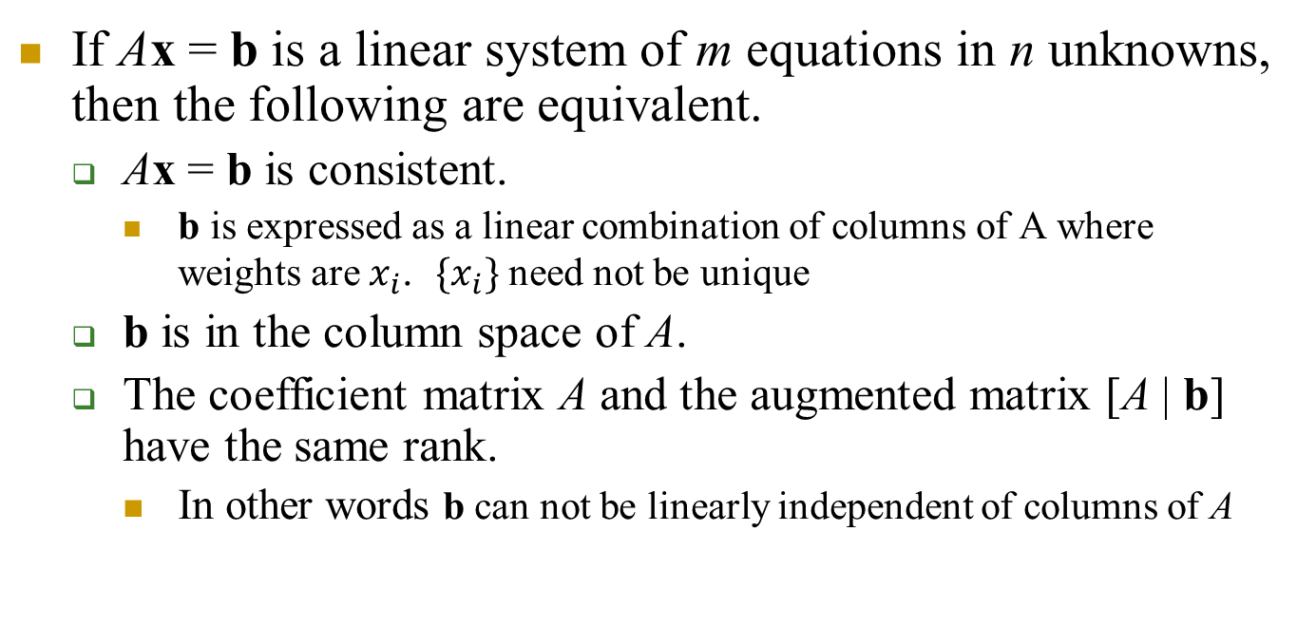
Theorem 5.6.5 (The Consistency Theorem)
If Ax = b is a linear system of m equations in n unknowns, then the following are equivalent.
Ax = b is consistent.
b is expressed as a linear combination of columns of A where weights are $x_{i}$. ${\{x}_{i}\}$ need not be unique
b is in the column space of A.
The coefficient matrix A and the augmented matrix [A | b] have the same rank.
In other words b can not be linearly independent of columns of A

Slide 114
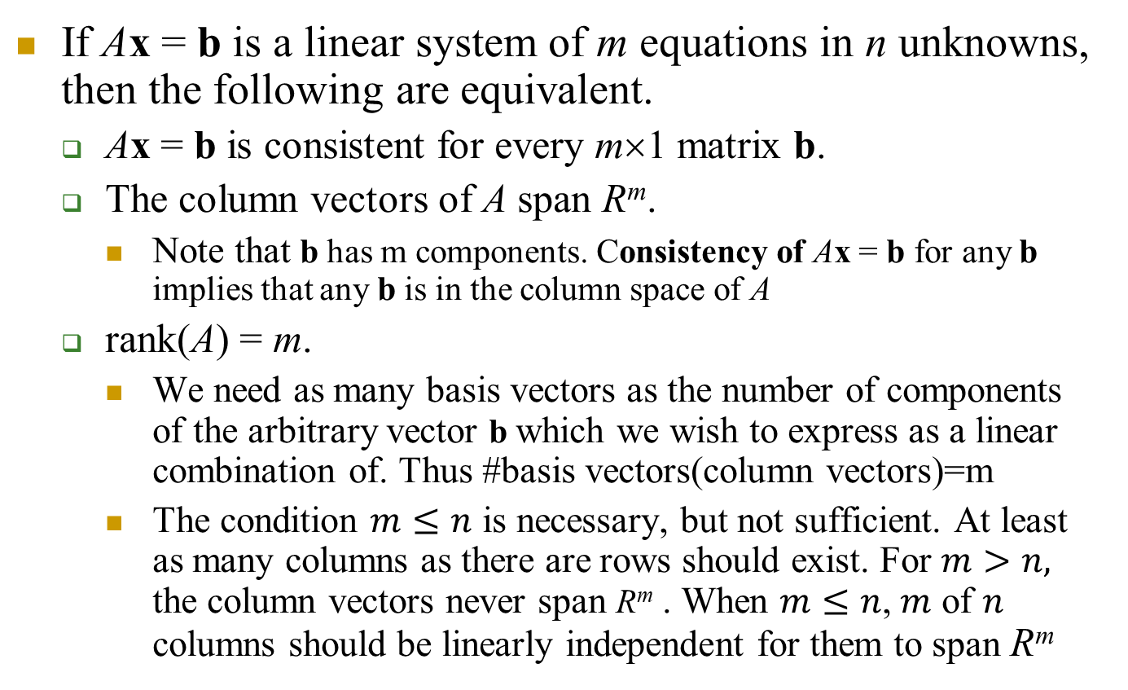
Theorems 5.6.6
If Ax = b is a linear system of m equations in n unknowns, then the following are equivalent.
Ax = b is consistent for every m×1 matrix b.
The column vectors of A span R^{m}.
Note that b has m components. Consistency of Ax = b for any b implies that any b is in the column space of A
rank(A) = m.
We need as many basis vectors as the number of components of the arbitrary vector b which we wish to express as a linear combination of. Thus #basis vectors(column vectors)=m
The condition $m≤n$ is necessary, but not sufficient. At least as many columns as there are rows should exist. For $m>n,$ the column vectors never span R^{m} . When $m≤n$, $m$ of $n$ columns should be linearly independent for them to span R^{m}

Slide 115
5-6 Overdetermined System
A linear system with more equations than unknowns is called an overdetermined linear system.
If Ax = b is an overdetermined linear system of m equations in n unknowns (so that m > n), then the column vectors of A cannot span R^{m}.
There exists b for which soln. does not exist.
Thus, the overdetermined linear system Ax = b cannot be consistent for every possible b.

Slide 116
5-6 Example 5
The linear system is overdetermined, so it cannot be consistent for all possible values of b₁, b₂, b₃, b₄, and b₅. Exact conditions under which the system is consistent can be obtained by solving the linear system by Gauss-Jordan elimination.

Slide 117
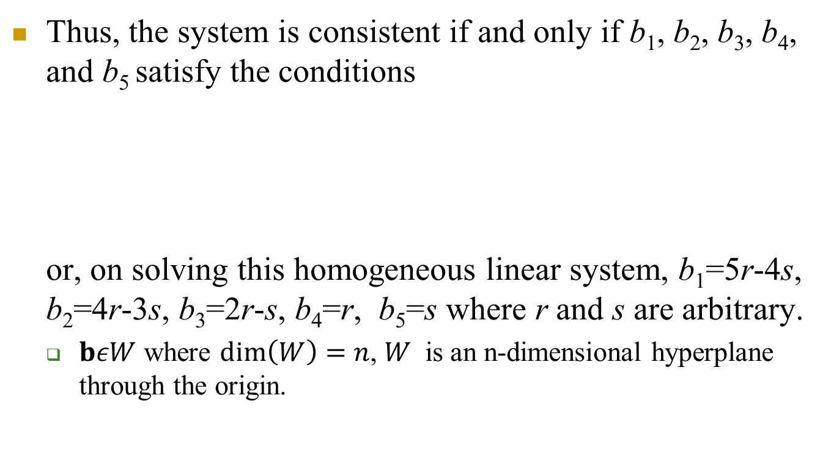
5-6 Example 5 (cont)
Thus, the system is consistent if and only if b₁, b₂, b₃, b₄, and b₅ satisfy the conditions or, on solving this homogeneous linear system, b₁=5r-4s, b₂=4r-3s, b₃=2r-s, b₄=r, b₅=s where r and s are arbitrary.
$bεW$ where $\dim\left(W\right)=n$, $W$ is an n-dimensional hyperplane through the origin.

Slide 118
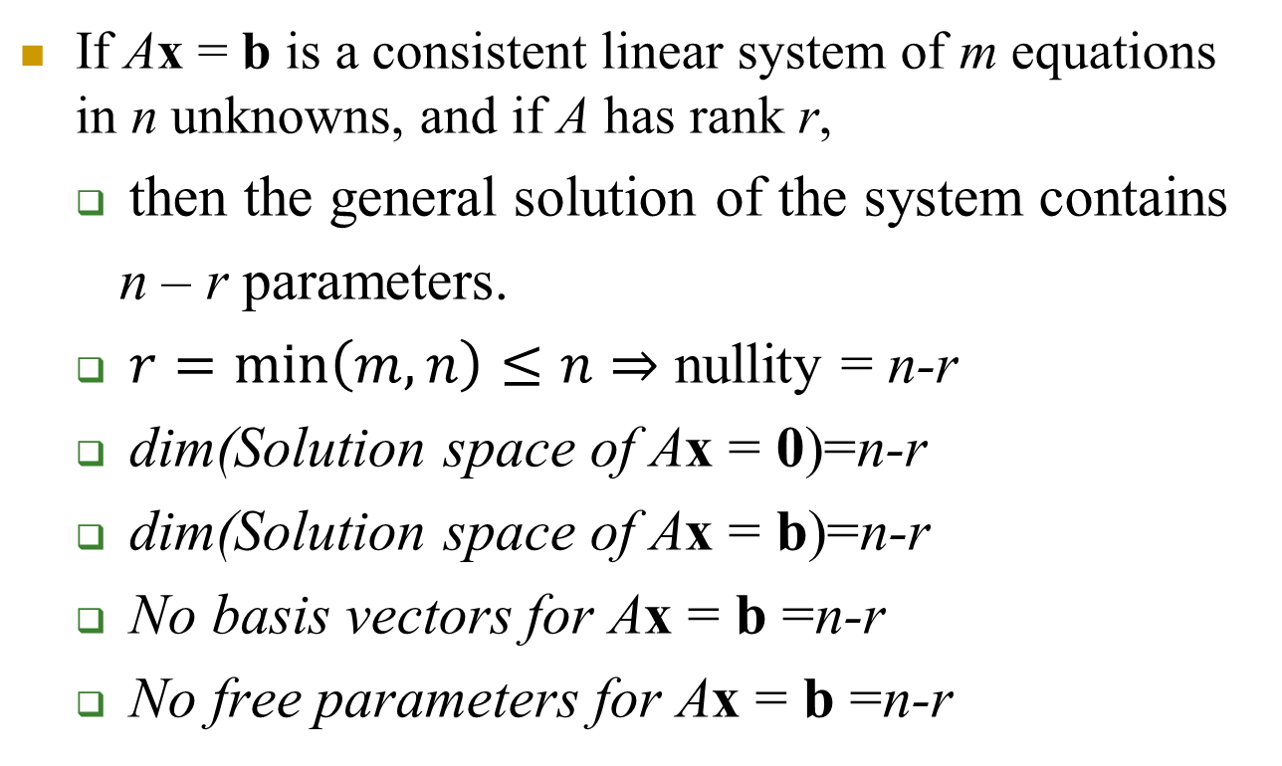
Theorem 5.6.7
If Ax = b is a consistent linear system of m equations in n unknowns, and if A has rank r,
then the general solution of the system contains
n – r parameters.
$r=\min\left(m,n\right)≤n$ $⇒$ nullity = n-r
dim(Solution space of Ax = 0)=n-r
dim(Solution space of Ax = b)=n-r
No basis vectors for Ax = b =n-r
No free parameters for Ax = b =n-r

Slide 119
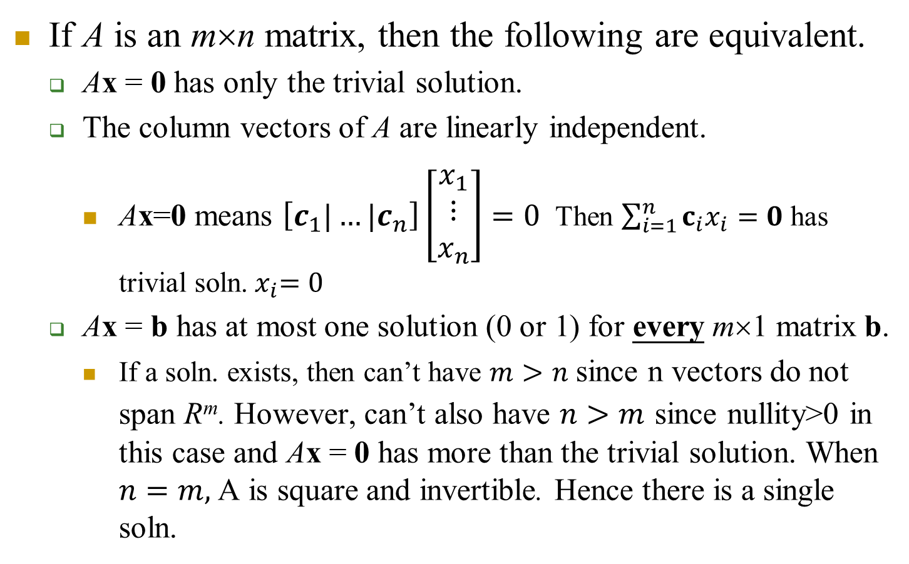
Theorem 5.6.8
If A is an m×n matrix, then the following are equivalent.
Ax = 0 has only the trivial solution.
The column vectors of A are linearly independent.
Ax=0 means $\left[c_{1}|…|c_{n}\right]\left[\begin{aligned}x_{1} \\ ⋮ \\ x_{n}\end{aligned}\right]=0$ Then $\sum_{i=1}^{n}{c_{i}x_{i}}=0$ has trivial soln.${ x}_{i}=0$
Ax = b has at most one solution (0 or 1) for every m×1 matrix b.
If a soln. exists, then can’t have $m>n$ since n vectors do not span R^{m}. However, can’t also have $n>m$ since nullity>0 in this case and Ax = 0 has more than the trivial solution. When $n=m,$A is square and invertible. Hence there is a single soln.

Slide 120
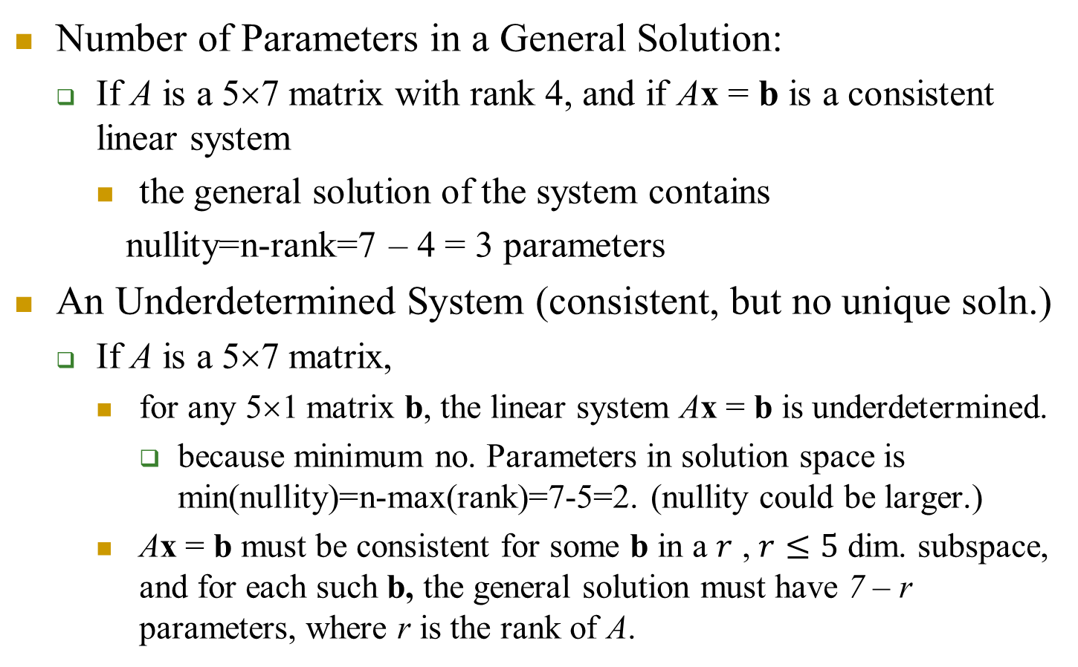
5.6 Example 7
Number of Parameters in a General Solution:
If A is a 5×7 matrix with rank 4, and if Ax = b is a consistent linear system
the general solution of the system contains
nullity=n-rank=7 – 4 = 3 parameters
An Underdetermined System (consistent, but no unique soln.)
If A is a 5×7 matrix,
for any 5×1 matrix b, the linear system Ax = b is underdetermined.
because minimum no. Parameters in solution space is min(nullity)=n-max(rank)=7-5=2. (nullity could be larger.)
Ax = b must be consistent for some b in a $r$ , $r≤5$ dim. subspace, and for each such b, the general solution must have 7 – r parameters, where r is the rank of A.

Slide 121
Theorem 5.6.9 (Equivalent Statements)
If A is an m×n matrix, and if T_{A} : R^{n} → R^{n} is multiplication by A, then the following are equivalent:
A is invertible.
Ax = 0 has only the trivial solution.
The reduced row-echelon form of A is I_{n}.
A is expressible as a product of elementary matrices.
Ax = b is consistent for every n×1 matrix b.
Ax = b has exactly one solution for every n×1 matrix b.
det(A)≠0.
The range of T_{A} is R^{n}.
T_{A} is one-to-one.
The column vectors of A are linearly independent.
The row vectors of A are linearly independent.
The column vectors of A span R^{n}.
The row vectors of A span R^{n}.
The column vectors of A form a basis for R^{n}.
The row vectors of A form a basis for R^{n}.
A has rank n.
A has nullity 0.

